Slide 1
Afib and Heart Failure Together
What Does it Mean?
And What You Can Do

Slide 2
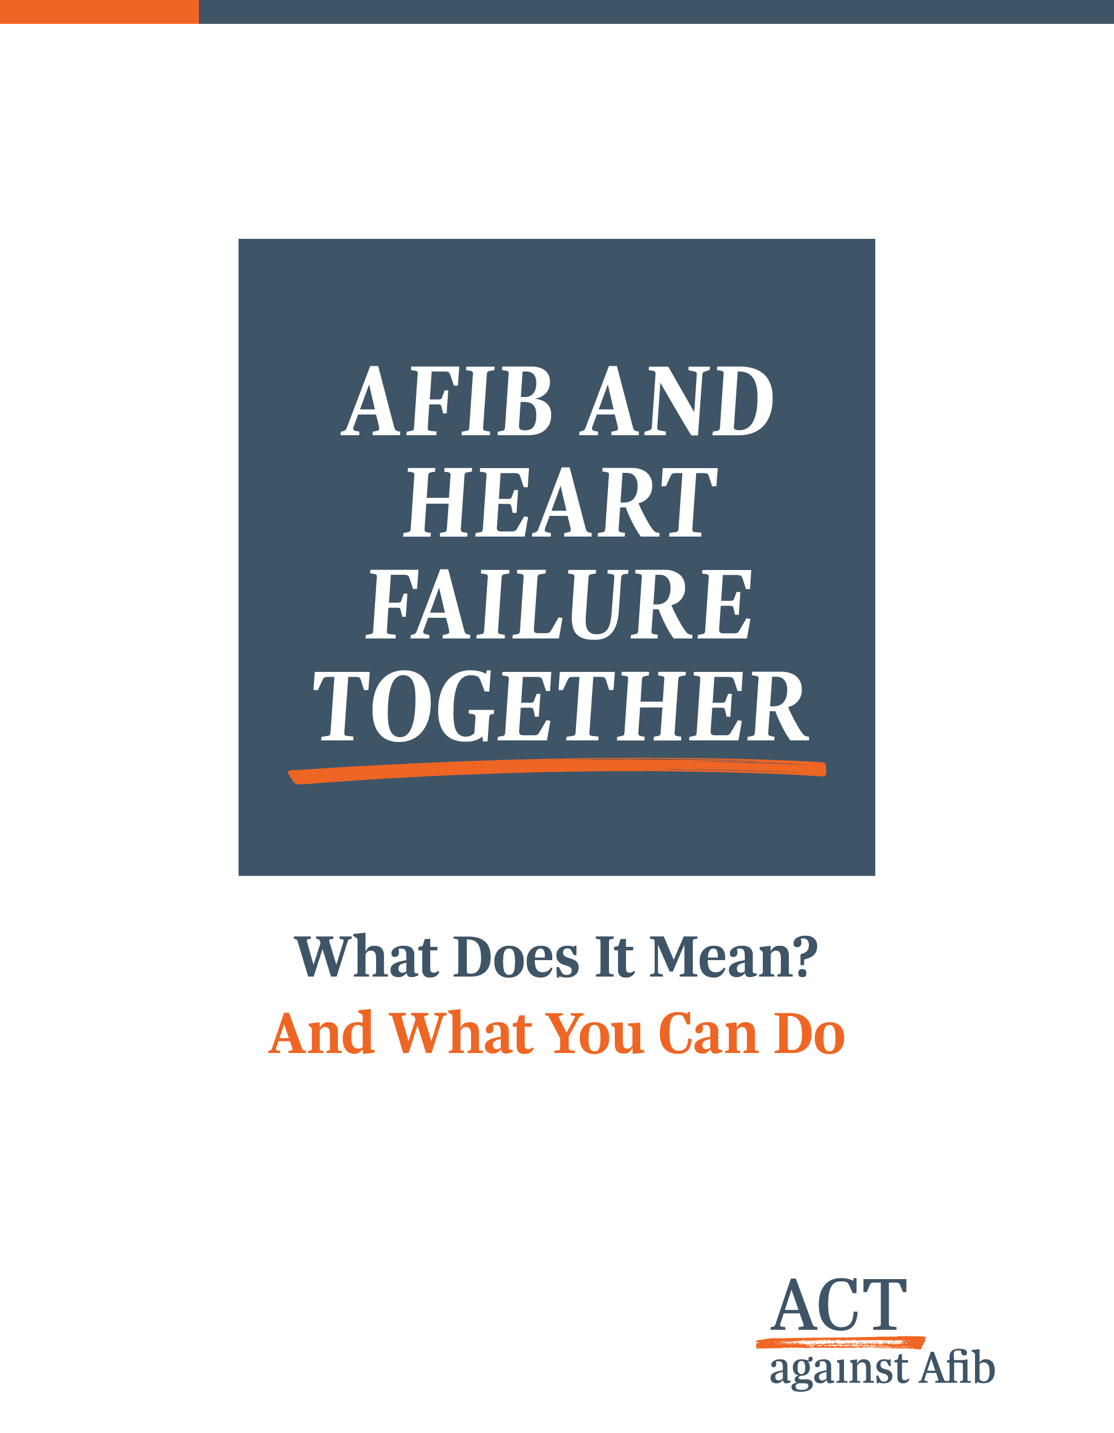

Slide 3
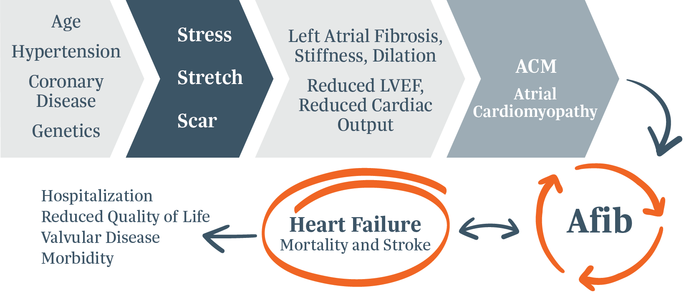
Structure and Rhythm Both Play a Role in Cardiac Output

Slide 4
Afib can lead to decompensation or it can be the primary stimulus for the development of HF¹
Cardiac surgeons have the golden opportunity at the time of surgery for a valve problem or coronary artery blockage to halt the progression of heart failure symptoms and restore sinus rhythm.
Atrial fibrillation (Afib) can lead to heart failure (HF) or worsen it, which carries an increased risk of stroke and death¹ - and, HF happens to be the leading cause of death in Afib patients.² However, Afib is ignored almost 80% of the time in patients already undergoing surgery^{3,4} - even with a Class I guideline recommendation.
Evidence has proven that Afib and HF co-mingle, decreasing patients' longevity.⁵ Treating Afib in the setting of large left atria and reduced ejection fraction can improve the quality of patients' lives after surgery and help them return to a normal life expectancy curve.⁴
HF is the leading cause of death in Afib patients.²

Slide 5



The Imminent Epidemic of Afib and Its Concomitant Diseases A Cause for Concern
After age 40:
1 in 4 people will develop Afib⁶
1 in 5 people will develop HF⁷
HF prevalence is expected to increase by 46% and costs will double to $70 billion by 2030¹
Afib and HF are two conditions that are likely to dominate the next 50 years of cardiovascular care.⁸

Slide 6
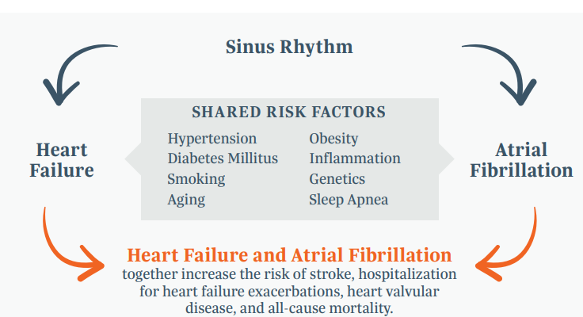
Hiding in Plain Sight Shared Risk Factors
Incidence of Afib and HF has been related to classic cardiovascular risk factors, generating a pro-inflammatory environment and fibrosis - a common basis of both diseases.⁹
Afib can share many of the same risk factors as HF, making it difficult to detect, and promotes HF development through multiple mechanisms.¹
Afib contributes to left ventricular dysfunction leading to HF.⁵
A person with A fib is 5x more likely to develop HF.¹⁰

Slide 7
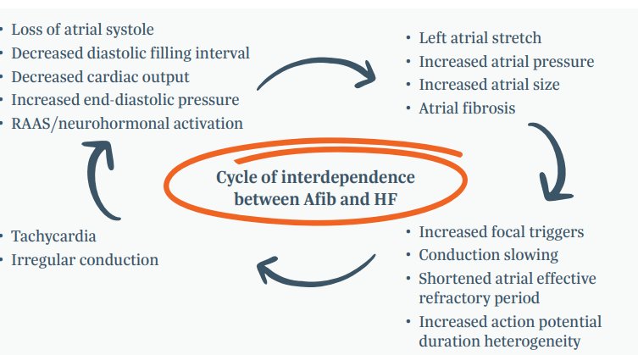
The Vicious Cycle Ignoring Afib Can Lead to HF – or Worsen It
Previous studies and surveys have shown that common underlying symptoms such as an enlarged left atrium and reduced ejection fraction are perceived barriers for the treatment of Afib in cardiac surgery patients.³
What can seem like a short-term barrier to treating Afib can be a marker for long-term development or worsening of HF. Patients can still continue a negative progression following structural heart surgery.
29% of Afib patients die within a decade of diagnosis.²

Slide 8
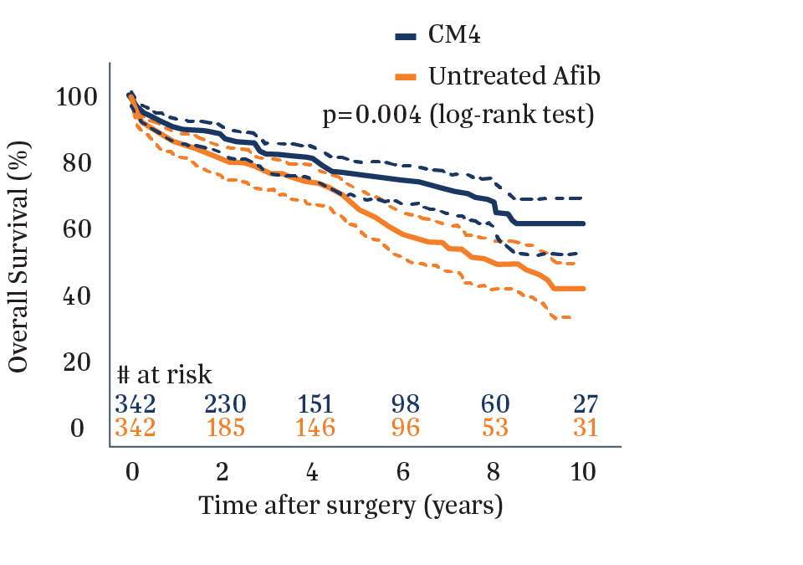
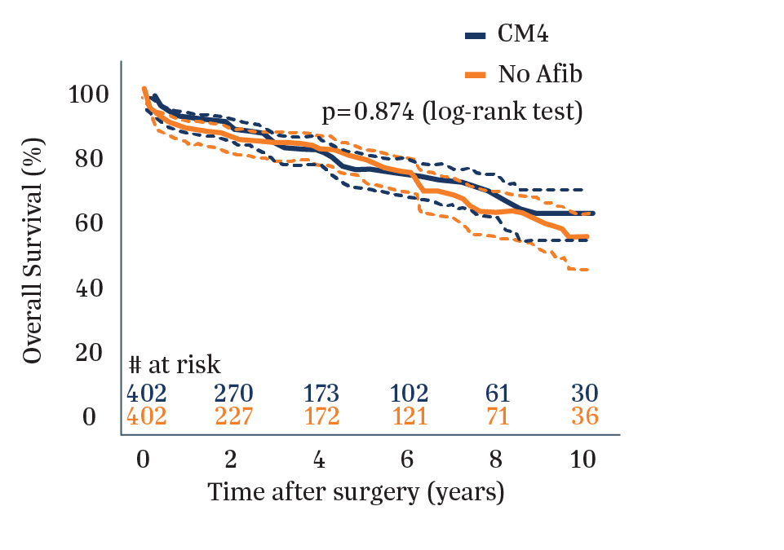
Benefits of Restoring Sinus Rhythm
Take advantage at the time of cardiac surgery to halt the progression of HF symptoms
Matched comparisons demonstrate that cardiac surgery patients with Afib who have surgical ablation have improved outcomes, without sacrificing perioperative safety.^{4,11}
Patients with Afib and HF who spend a higher proportion of time in sinus rhythm suffer less severe functional impairment.⁸
Figure: Kaplan-Meier curve showing the survival of the matched
Restoring sinus rhythm puts the patient back on the same life expectancy curve as if they never had Afib.¹¹

Slide 9



Afib and HF Together: What Does It Mean?
It means:
Afib will accelerate progressive damage to the heart, reducing cardiac output which can cause or worsen heart failure.
Reduced quality of life, more hospitalization, and increased risk of stroke and death.
It’s time to treat Afib as a long-term risk, taking advantage of the opportunity at the time of surgery to restore cardiac output and improving quality of like and survival for patients.

Slide 10
To find out more, visit ACTagainstAfib.com

Slide 11
References
¹Carlisle, M.A., Pudim, M., DeVore, A. D., & Piccini, J. P. (2019). Heart failure and atrial fibrillation, like fire and fury. JACC: Heart Failure, 7(6):447-56. ^{﻿﻿2}Pauchier, L. et al (2016). Causes of death and influencing factors in patients with atrial fibrillation. The American Journal of Medicine, 129(12) :1278-87. ³﻿﻿Mehaffey, J.H. et al. (2021). Barriers to atrial fibrillation ablation during mitral valve surgery. The Journal of Thoracic and Cardiovascular Surgery. ⁴McCarthy, PM. et al. (2021). Surgery and Catheter Ablation for Atrial Fibrillation: History, Current Practice, and Future Directions. J Clin Med, 11(1) 210, DOL: 10.3390/ jom11010210. PMID: 35011953; PMCID: PMC8745682. ⁵Gerdisch, M. (2022). The most beneficial options for patients with arrhythmia and concomitant structural heart disease: a review. A.ME Surgical Journal, 3,DOL:10.21037 /as] 22-18. ⁶Lloyd-Jones, D.M. et al (2004). Lifetime risk for development of atrial fibrillation: the Framingham Heart Study: Circulation, 110(9):1042-46. ⁷Lloyd-Jones, D.M. et al. (2002). Lifetime risk for developing congestive heart failure: the Framingham Heart Study. Circulation, 106:3068-72 ⁸Kotecha, D. & Piccini, I.P. (2015). Atrial fibrillation in heart failure: what should we do? Eur Heart J, 36(46):3250-7. DOI: 10.1093/eurheartj/ehv513. Epub 2015 Sep 28. PMID: 26419625; PMCID: PMC4670966. ⁹Boerschel, C. S. & Schnabel, R. B. (2019). The imminent epidemic of atrial fibrillation and its concomitant diseases- myocardial infarction and heart failure a cause for concern. International Journal of Cardiology, 287162-73. ¹⁰Odutayo, A. et al. (2016). Atrial fibrillation and risks of cardiovascular disease, renal disease, and deaths systematic review and meta analysis. BMJ 2016; 354:14482. ¹¹Musharbash, F.N et al. (2018). Performance of the Cox maze IV procedure is associated with improved long term survival in patients with atrial fibrillation undergoing cardiac surgery. The Journal of Thoracie and Cardiovascular Surgery, 155(1):159-170

