Slide 1

PM-GL-0416F-0226-G

Slide 2
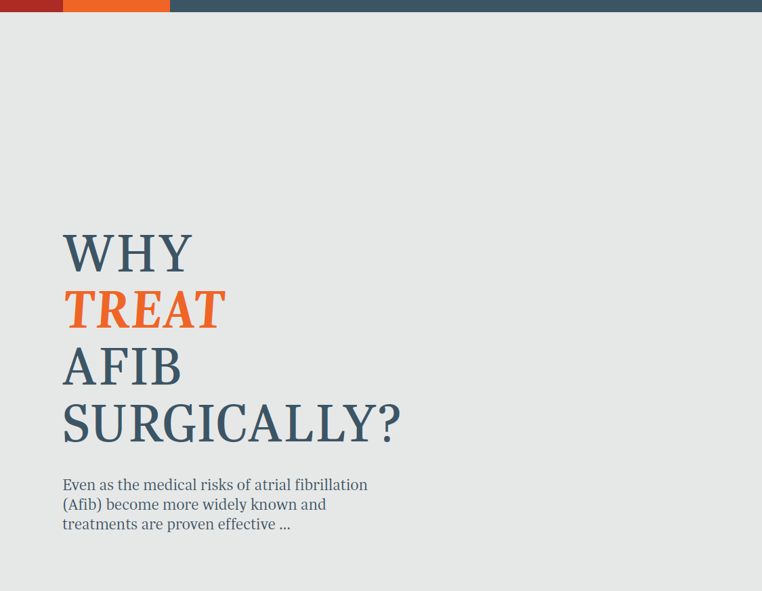
PM-GL-0416F-0226-G

Slide 3
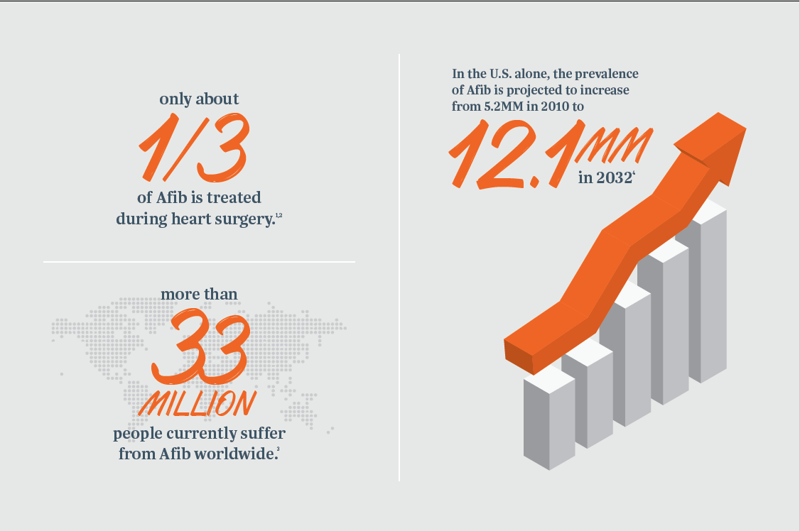
Why Treat Afib Surgically?
PM-GL-0416F-0226-G

Slide 4
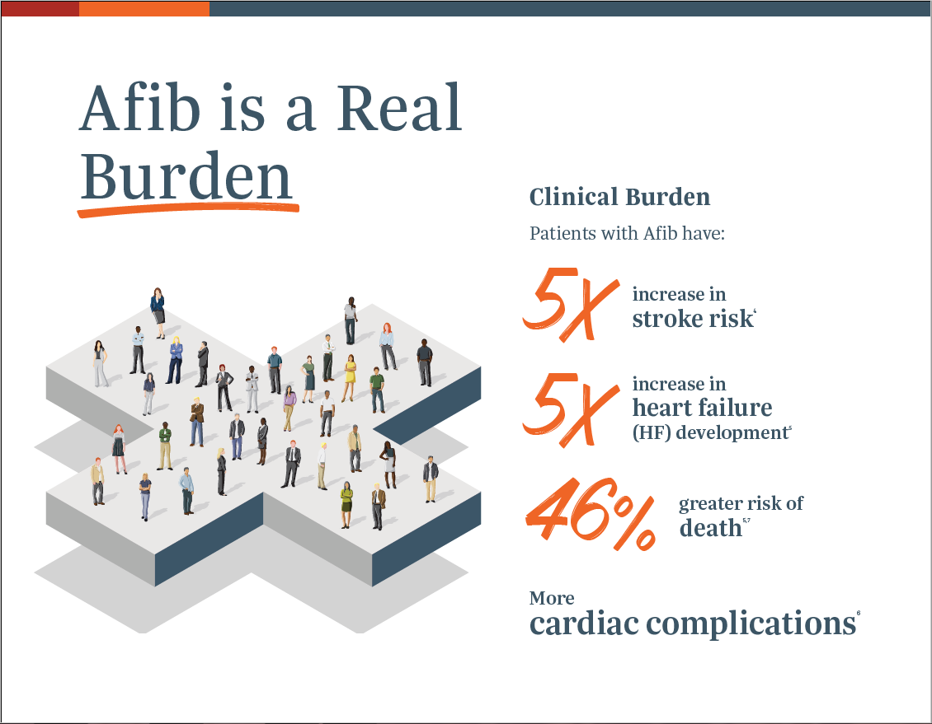
PM-GL-0416F-0226-G

Slide 5
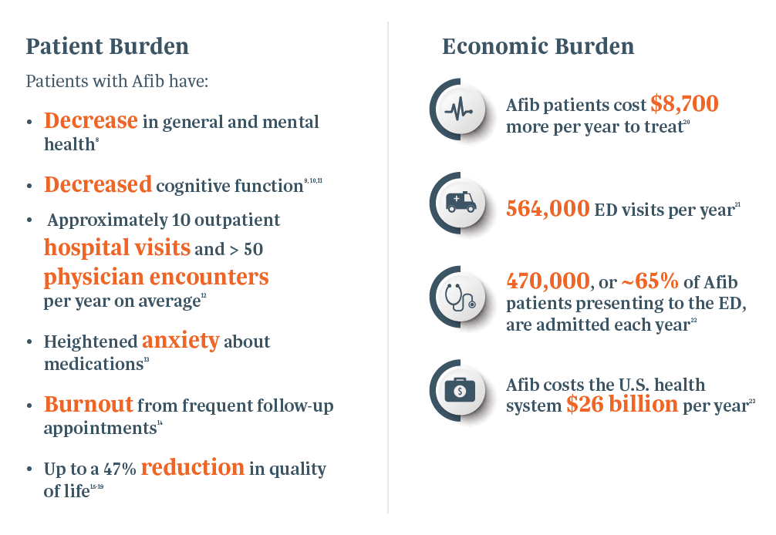
Afib is a Real Burden
PM-GL-0416F-0226-G

Slide 6

*Sources:
Adapted from: Piccini, J.P. et al. (2014). Clinical course of atrial fibrillation in older adults: the importance of cardiovascular events beyond stroke. Eur Heart J, 35(4):250-6.
Adapted from: Howlader, N. et al. SEER Cancer Statistics Review, 1975-2010. National Cancer Institute. Bethesda, MD, https://seer.cancer.gov/archive/csr/1975_2010/, based on November 2012 SEER data submission, posted to the SEER website, April 2013.
PM-GL-0416F-0226-G

Slide 7
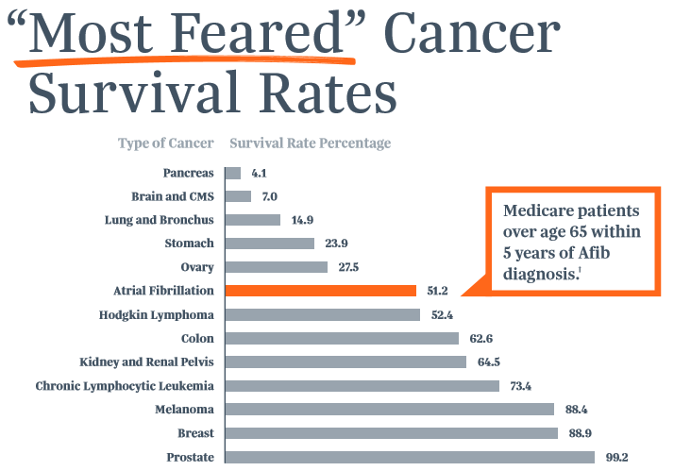
Severity of Afib is Often Misunderstood
Sources: †Piccini, J.P. et al. (2014). Clinical course of atrial fibrillation in older adults: the importance of cardiovascular events beyond stroke. Eur Heart J, 35(4):250-6. *Adapted from: Howlader, N. et al. SEER Cancer Statistics Review, 1975-2010. National Cancer Institute. Bethesda, MD, https://seer.cancer.gov/archive/csr/1975_2010/, based on November 2012 SEER data submission, posted to the SEER website, April 2013.
PM-GL-0416F-0226-G
Notes:
Atrial fibrillation is becoming more well known for its dangerous effects on health, but let’s compare atrial fibrillation to cancer.
Cancer is a scary word for most people, and by no means do we diminish the impact or feeling one must have if they or a loved one receive a cancer diagnosis.
However, when we compare atrial fibrillation to all invasive cancers only slightly more than half of AF patients will be alive five years after diagnosis, while overall 6 out of 10 cancer patients will survive five years post diagnosis.

Slide 8
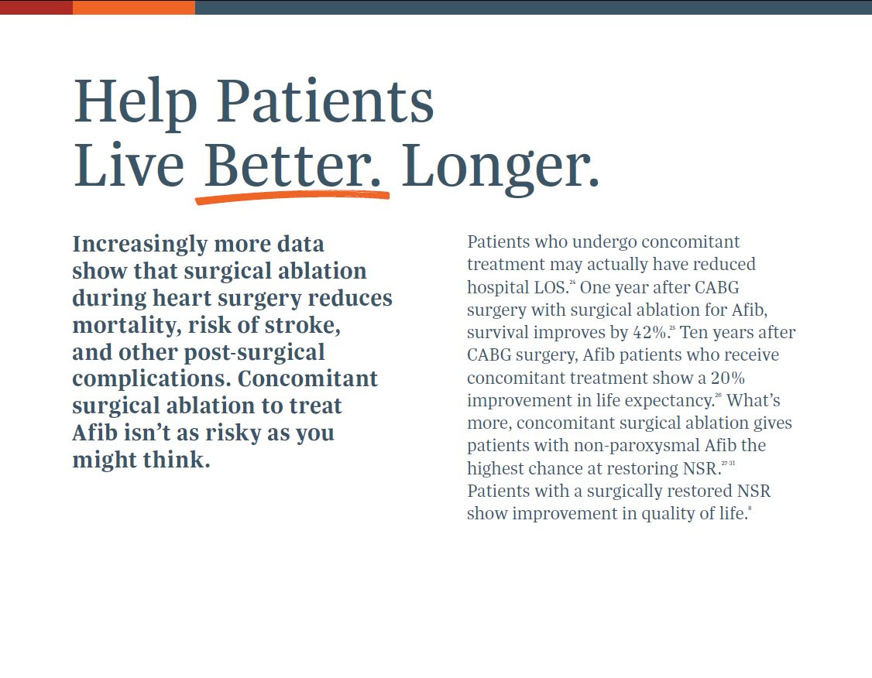
LOS: length of stay
NSR: normal sinus rhythm
CABG: coronary artery bypass graft
PM-GL-0416F-0226-G

Slide 9
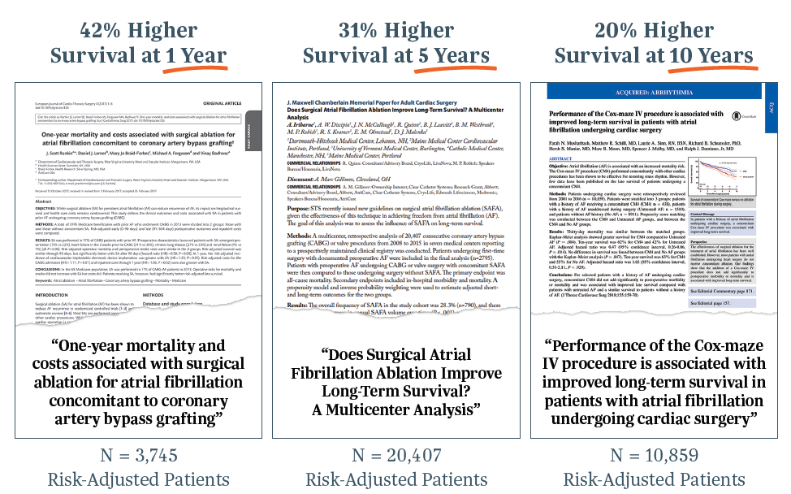
Help Patient Live Better. Longer.
PM-GL-0416F-0226-G

Slide 10
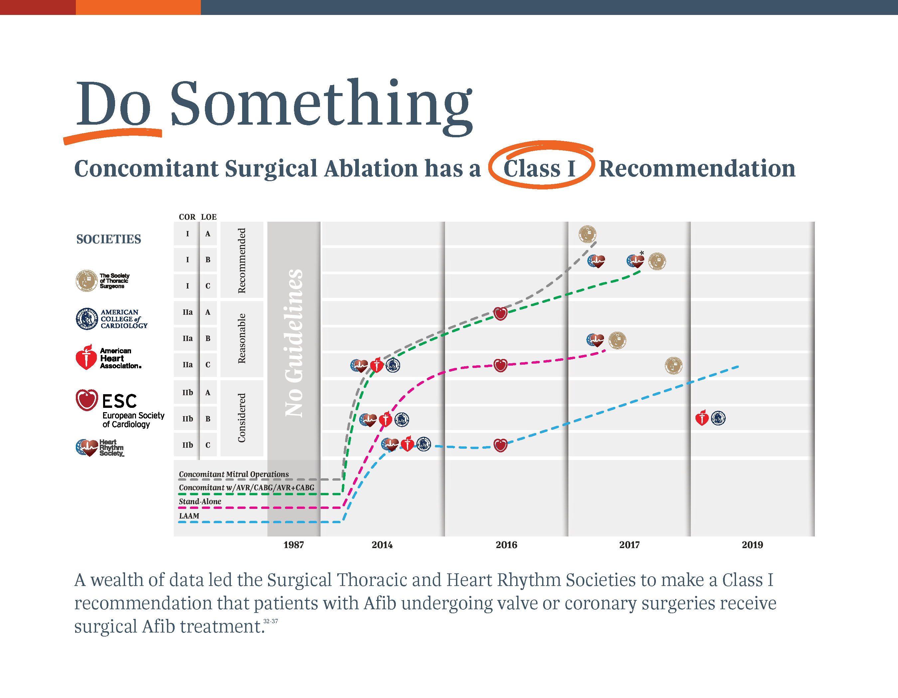
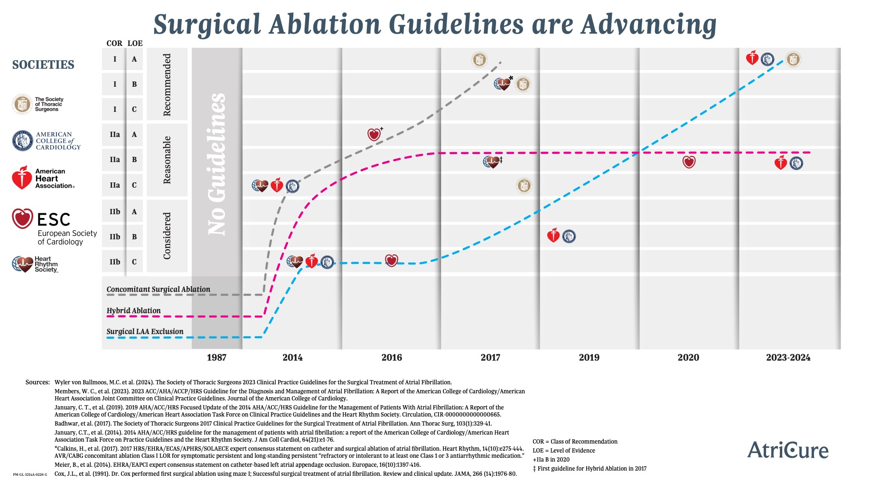
*AVR/CABG concomitant ablation Class I LDR for symptomatic persistent and long-standing persistent “refractory or intolerant to at least one Class I or III antiarrhythmic medication.”
PM-GL-0416F-0226-G

Slide 11
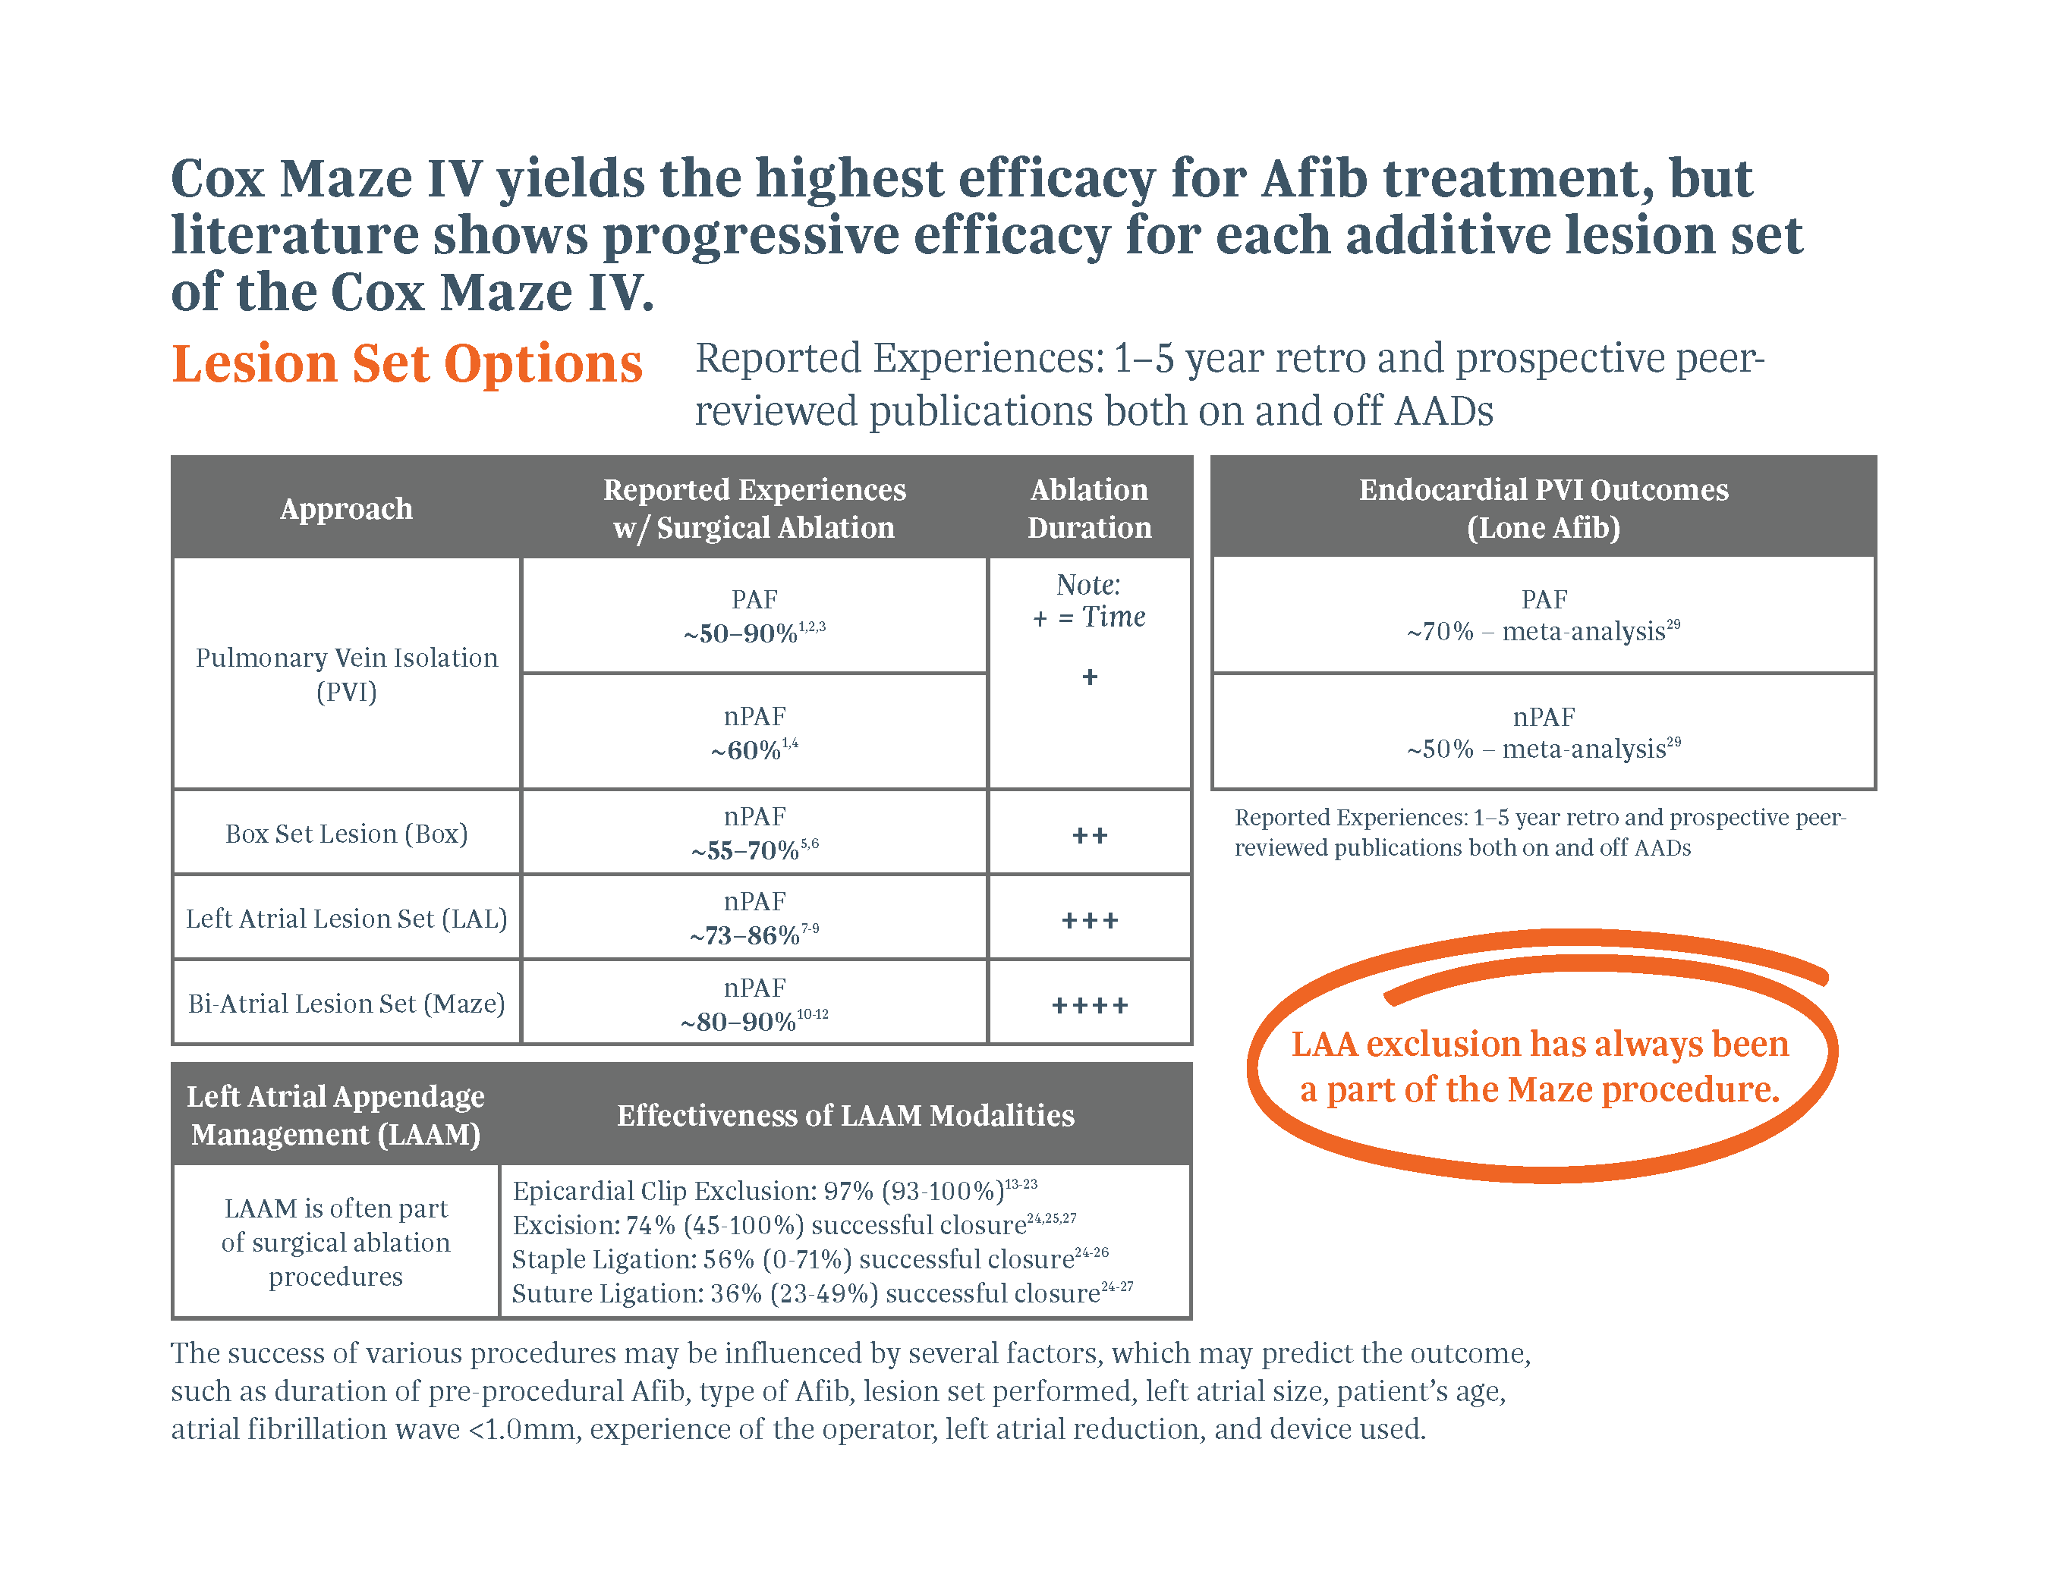
Do Something
See Appendix A for References.
AADs: antiarrythmic drugs
PM-GL-0416F-0226-G

Slide 12

MVR: mitral valve repair/replacement
PM-GL-0416F-0226-G

Slide 13
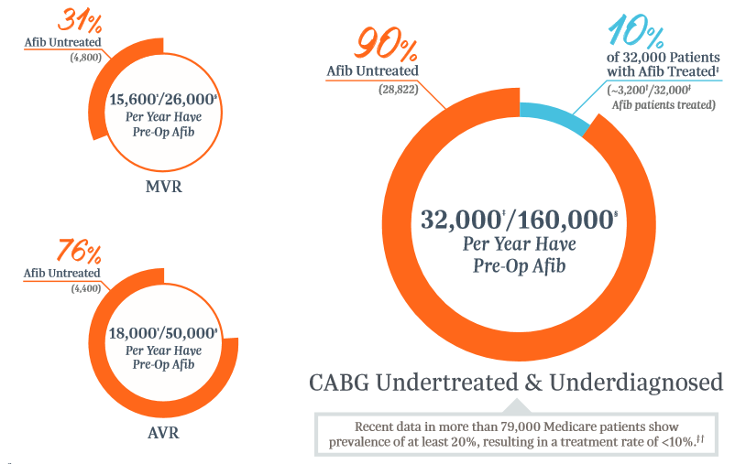
Afib is Surgically Undertreated
Sources:
1 Badhwar, V. et al. (2017). Surgical ablation of atrial fibrillation in the United States: trends and propensity matched outcomes. Ann of Thorac Surg, 104(2):493-500 Afib incidence pre-op by type of surgery. Reports incidence of Afib in MVR as 60% and AVR as 36%. § McCarthy, P.M. et al. (2019). Prevalence of atrial fibrillation before cardiac surgery and factors associated with concomitant ablation. J Thorac Cardiovasc Surg, PII: S0022-5223(19) 31361-3, DOI: 10.1016/J.JTCVS.2019.06.062. Showed 20% prevalence of Afib in CABG based on CMS data showing admission for Afib 3 years prior to CABG. † Braid-Forbes Health Research analysis of 2014 CMS SAF data: Annual Counts and Proportions of Atrial Fibrillation and Concomitant Surgical Atrial Ablation in US Cardiac Surgeries. Presented to AtriCure August 22, 2016. Showed 3,121 SA treatments during isolated CABG surgeries. Internal data on file. ‡ Society of Thoracic Surgery Database.
PM-GL-0416F-0226-G

Slide 14

PM-GL-0416F-0226-G

Slide 15
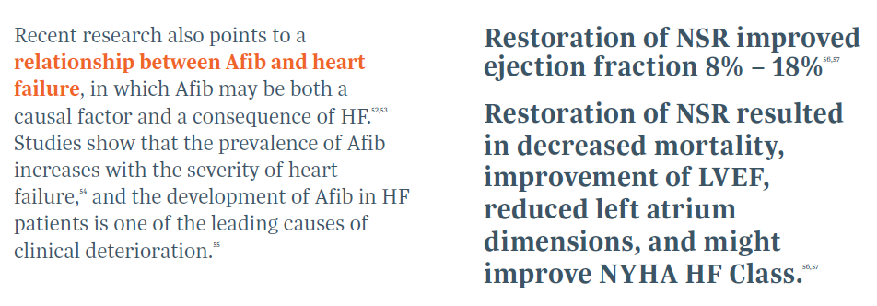
Be Part of the Heart Failure Solution
LVEF: left ventricular ejection fraction
NYHA: New York Heart Association
PM-GL-0416F-0226-G

Slide 16
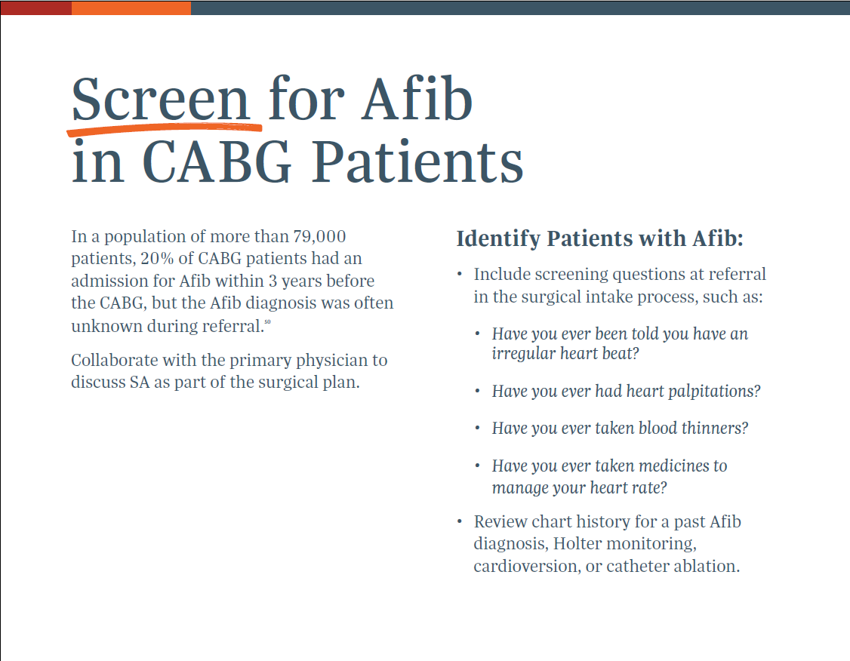
PM-GL-0416F-0226-G

Slide 17
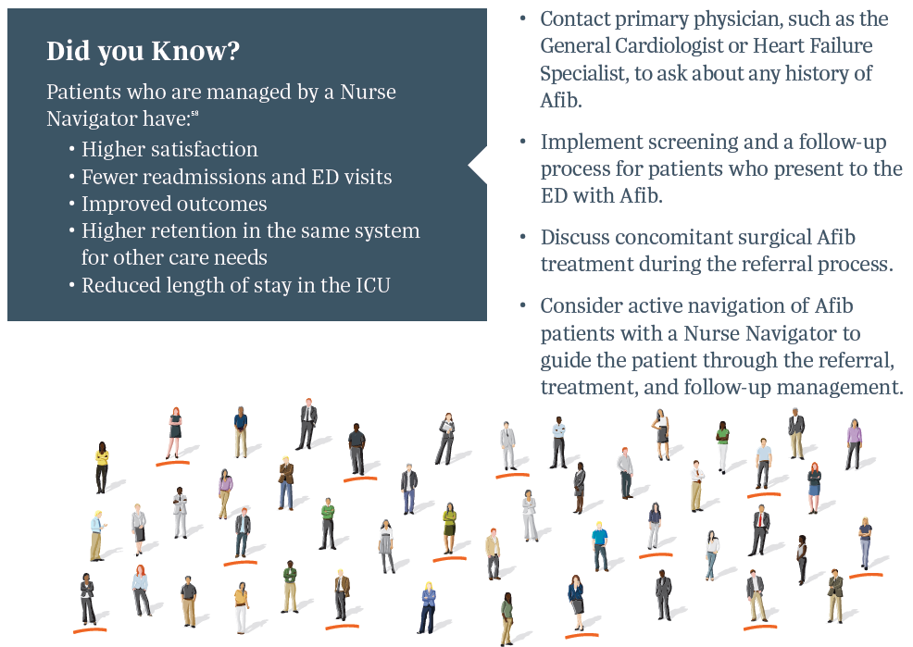
Screen for Afib in CABG Patients
PM-GL-0416F-0226-G

Slide 18

Ready to ACT against Afib?
This material is intended to provide general information, including opinions and recommendations, contained herein for educational purposes only. Such information is not intended to be a substitute for professional medical advice, diagnosis or treatment. The material is not intended to direct clinical care in any specific circumstance. The judgment regarding a particular clinical procedure or treatment plan must be made by a qualified physician in light of the clinical data presented by the patient, the diagnostic and treatment options available.
PM-GL-0416F-0226-G

Slide 19
Individual results may vary. Please consult with your physician regarding your condition and appropriate medical treatment.
This material is intended to provide general information, including opinions and recommendations, contained herein for educational purposes only. Such information is not intended to be a substitute for professional medical advice, diagnosis or treatment. The material is not intended to direct clinical care in any specific circumstance. The judgment regarding a particular clinical procedure or treatment plan must be made by a qualified physician in light of the clinical data presented by the patient, the diagnostic and treatment options available.
PM-GL-0416F-0226-G

Slide 20

Sources
1 Badhwar, V. et al. (2017). Surgical ablation of atrial fibrillation in the United States: trends and propensity matched outcomes. Ann of Thorac Surg, 104(2):493-500.
2 Braid-Forbes, M.J. Health Research, 2014 CMS SAF, August 2016. NIS for volume and Medicare to look back over 3 years and obtained diagnosis.
3 Rahman, F., Kwan, G.F., & Benjamin, E.J. (2014). Global epidemiology of atrial fibrillation. Nat Rev Cardiol, 11(11):639-54.
4 Colilla, S. et al. (2013). Estimates of current and future incidence and prevalence of atrial fibrillation in the U.S. adult population. Am J Cardiol, 112(8):1142-7.
5 Odutayo, A. et al. (2016). Atrial fibrillation and risks of cardiovascular disease, renal disease, and death: systematic review and meta-analysis. BMJ; 354:i4482.
6 Fukunaga, S. et al. (2008). Effect of surgery for atrial fibrillation associated with mitral valve disease. Ann of Thorac Surg, 86(4):1212-7.
7 Boriani, G., & Proietti, M. (2017). Atrial fibrillation prevention: an appraisal of current evidence. Heart, 104(11):882-7.
8 Forlani, S. et al. (2006). Conversion to Sinus Rhythm by Ablation Improves Quality of Life in Patients Submitted to Mitral Valve Surgery. Ann of Thorac Surg, 81(3):863-7.
9 Zoni-Berisso, M., Lercari, F., Carazza, T., & Domenicucci, S. (2014). Epidemiology of atrial fibrillation: European perspective. Clin Epidemiol, 6:213-20.
10 Zoni-Berisso, M. et al. (2013). Frequency, patient characteristics, treatment strategies, and resource usage of atrial fibrillation (from the Italian Survey of Atrial Fibrillation Management [ISAF] study). Am J Cardiol, 111(5):705-11.
11 Ott, A. et al. (1997). Atrial fibrillation and dementia in a population-based study. The Rotterdam Study. Stroke, 28(2):316-21.
12 Sullivan, E., Braithwaite, S., Dietz, K., & Hickey, C. (2010). Health services utilization and medical costs among Medicare atrial fibrillation patients. Avalere Health, 4(2):7.
13 Wang, Y., Kong, M.C., Lee, L.H., Ng, H.J., & Ko, Y. (2014). Knowledge, satisfaction, and concerns regarding warfarin therapy and their association with warfarin adherence and anticoagulation control. Thromb Res, 133(4):550-4.
14 Altiok, M., Yilmaz, M., & Rencüsogullari, I. (2015). Living with Atrial Fibrillation: An Analysis of Patients’ Perspectives. Asian Nursing Research, 9(4):305-11.
15 Nazli, C. et al. (2016). Impaired quality of life in patients with intermittent atrial fibrillation. Anatol J Cardiol, 16(4):250-5.
16 Thrall, G., Lane, D., Carroll, D., & Lip, G.Y. (2006). Quality of life in patients with atrial fibrillation: a systematic review. Am J Med, 119(5):448.e1-19.
17 Hagens, V.E. et al. (2004). Effect of rate or rhythm control on quality of life in persistent atrial fibrillation. Results from the Rate Control Versus Electrical Cardioversion (RACE) Study. J Am Coll Cardiol, 43(2):241-7.
18 Hoegh, V. et al. (2016). Association between the diagnosis of atrial fibrillation and aspects of health status: a Danish cross-sectional study. Scand J Caring Sci, 30(3):507-17.
19 Dorian, P. et al. (2000). The impairment of health-related quality of life in patients with intermittent atrial fibrillation: implications for the assessment of investigational therapy. J Am Coll Cardiol, 36(4):1303-9.
20 Centers for Disease Control and Prevention. (2017). Atrial Fibrillation Fact Sheet. Accessed Dec 2018. Retrieved from https://www.cdc.gov/dhdsp/data_statistics/fact_sheets/fs_atrial_fibrillation.htm.
21 McDonald, A.J., Pelletier, A.J., Ellinor, P.T., & Camargo Jr., C.A. (2008). Increasing US emergency department visit rates and subsequent hospital admissions for atrial fibrillation from 1993 to 2004. Ann Emerg Med, 51(1):58-65.
22 Rozen, G. et al. (2018). Emergency Department Visits for Atrial Fibrillation in the United States: Trends in Admission Rates and Economic Burden From 2007 to 2014. J Am Heart Assoc, 7(15), PII:e009024.
23 Kim, M.H., Johnston, S.S., Chu, B.C., Dalal, M.R., & Schulman, K.L. (2011). Estimation of total incremental health care costs in patients with atrial fibrillation in the United States. Circ Cardiovasc Qual Outcomes, 4(3):313-20.
24 Iribarne, A. et al. (2019). Surgical Atrial Fibrillation Ablation Improves Long-Term Survival: A Multicenter Analysis. Ann of Thorac Surg, 107(1):135-42.
25 Rankin, J.S., Lerner, D.J., Braid-Forbes, M.J., Ferguson, M.A., & Badhwar, V. (2017). One-year mortality and costs associated with surgical ablation for atrial fibrillation concomitant to coronary artery bypass grafting. Eur J Cardiothorac Surg, 52(3):471-7.
26 Musharbash, F.N. et al. (2018). Performance of the Cox-maze IV procedure is associated with improved long-term survival in patients with atrial fibrillation undergoing cardiac surgery. J Thorac Cardiovasc Surg, 155(1):159-70.
27 Philpott, J.M. et al. (2015). The ABLATE Trial: Safety and Efficacy of Cox Maze-IV Using a Bipolar Radiofrequency Ablation System. Ann of Thorac Surg, 100(5):1541-8.
28 McCarthy, P.M. et al. (2019). Prevalence of Atrial Fibrillation before Cardiac Surgery and Factors Associated with Concomitant Ablation. J Thorac Cardiovasc Surg, PII: S0022-5223(19)31361-3, DOI: 10.1016/J.JTCVS.2019.06.062.
29 Gaynor, S.L. et al. (2015). Surgical treatment of atrial fibrillation: predictors of late recurrence. J Thorac Cardiovasc Surg, 129(1):104-11.
30 Weimar, T. et al. (2011). The Cox-maze IV procedure for lone atrial fibrillation: a single center experience in 100 consecutive patients. J Interv Card Electrophysiol. 31(1):47-54.
PM-GL-0416F-0226-G

Slide 21
Sources
31 Schill, M.R. et al. (2017). Late results of the Cox-maze IV procedure in patients undergoing coronary artery bypass grafting. J Thorac Cardiovasc Surg, 153(5):1087-94.
32 January, C. T., et al. (2019). 2019 AHA/ACC/HRS Focused Update of the 2014 AHA/ACC/HRS Guideline for the Management of Patients With Atrial Fibrillation: A Report of the American College of Cardiology/American Heart Association Task Force on Clinical Practice Guidelines and the Heart Rhythm Society. Circulation, CIR-0000000000000665.
33 Badhwar, V. et al. (2017). The Society of Thoracic Surgeons 2017 Clinical Practice Guidelines for the Surgical Treatment of Atrial Fibrillation. Ann of Thorac Surg, 103(1):329-41.
34 Calkins, H. et al. (2017). 2017 HRS/EHRA/ECAS/APHRS/SOLAECE expert consensus statement on catheter and surgical ablation of atrial fibrillation. Europace, 20(1):e1-e10.
35 January, C.T. et al. (2014). 2014 AHA/ACC/HRS guideline for the management of patients with atrial fibrillation: a report of the American College of Cardiology/American Heart Association Task Force on Practice Guidelines and the Heart Rhythm Society. J Am Coll Cardiol, 64(21):e1-e76.
36 Meier, B. et al. (2014). EHRA/EAPCI expert consensus statement on catheter-based left atrial appendage occlusion. Europace, 16(10):1397-416.
37 Cox, J.L. et al. (1991). Successful surgical treatment of atrial fibrillation. Review and clinical update. JAMA, 266(14):1976-80.
38 Ouyang, F. et al. (2010). Long-term results of catheter ablation in paroxysmal atrial fibrillation: lessons from a 5-year follow-up. Circulation, 122(23):2368-77.
39 Kirchhof, P. et al. (2016). 2016 ESC guidelines for the management of atrial fibrillation developed in collaboration with EACTS: the Task Force for the management of atrial fibrillation of the European Society of Cardiology (ESC) developed with the special contribution of the European Heart Rhythm Association (EHRA) of the ESC Endorsed by the European Stroke Organization (ESO). Europace, 18(11):1455-90.
40 Tilz, R.R. et al. (2010). Catheter ablation of long-standing persistent atrial fibrillation: a lesson from circumferential pulmonary vein isolation. J Cardiovasc Electrophysiol, 21(10):1085-93. (Abstract-Only).
41 Wynn, G.J. et al. (2016). Long-term outcomes after ablation of persistent atrial fibrillation: an observational study over 6 years. Open Heart, 3(2):e000394.
42 Gillinov, A.M. et al. (2005). Surgical ablation of atrial fibrillation with bipolar radiofrequency as the primary modality. J Thorac Cardiovasc Surg, 129(6):1322-9.
43 Gillinov, A.M. et al. (2015). Surgical ablation of atrial fibrillation during mitral-valve surgery. N Engl J Med, 372(15):1399-409.
44 Voeller, R.K. et al. (2008). Isolating the entire posterior left atrium improves surgical outcomes after the Cox maze procedure. J Thorac Cardiovasc Surg, 135(4):870-7.
45 Barnett, S.D., & Ad, N. (2006). Surgical ablation as treatment for the elimination of atrial fibrillation: a meta-analysis. J Thorac Cardiovasc Surg, 131(5):1029-35.
46 Cox, J.L., & Ad, N. (2000). The importance of cryoablation of the coronary sinus during the Maze procedure. Semin Thorac Cardiovasc Surg, 12(1):20-4.
47 Robertson, J.O. et al. (2013). Surgical Techniques Used for the Treatment of Atrial Fibrillation. Circ J, 77(8):1941-51.
48 Gillinov, A.M. et al. (2006). Surgery for permanent atrial fibrillation: impact of patient factors and lesion set. Ann Thorac Surg, 82(2):502-14.
49 Ad, N., Holmes, S.D., Lamont, D., & Shuman, D.J. (2017). Left-Sided Surgical Ablation for Patients With Atrial Fibrillation Who Are Undergoing Concomitant Cardiac Surgical Procedures. Ann Thorac Surg, 103(1):58-65.
50 Gammie, J.S. et al. (2008). Atrial fibrillation correction surgery: lessons from the Society of Thoracic Surgeons National Cardiac Database. Ann Thorac Surg, 85(3):909-14.
51 Maisel, W.H., & Stevenson, L.W. (2003). Atrial fibrillation in heart failure: epidemiology, pathophysiology, and rationale for therapy. Am J Cardiol, 91(6A):2D-8D.
52 Efremidis, M., Pappas, L., Sideris, A., & Filippatos, G. (2008). Management of atrial fibrillation in patients with heart failure. J Card Fail, 14(3):232-7.
53 Feinberg, W.M., Blackshear, J.L., Laupacis, A., Kronmal, R., & Hart, R.G. (1995). Prevalence, age distribution, and gender of patients with atrial fibrillation. Analysis and implications. Arch Intern Med, 155(5):469-73.
54 Hunt, S.A. et al. (2005). ACC/AHA 2005 Guideline Update for the Diagnosis and Management of Chronic Heart Failure in the Adult: a report of the American College of Cardiology/American Heart Association Task Force on Practice Guidelines (Writing Committee to Update the 2001 Guidelines for the Evaluation and Management of Heart Failure). J Am Coll Cardiol, 46(6):1116-1143.
55 Prabhu, S. et al. (2017). Catheter Ablation Versus Medical Rate Control in Atrial Fibrillation and Systolic Dysfunction: The CAMERA-MRI Study. J Am Coll Cardiol, 70(16):1949-61.
56 Marrouche, N.F., Brachmann, J., & CASTLE-AF Steering Committee. (2009). Catheter ablation versus standard conventional treatment in patients with left ventricular dysfunction and atrial fibrillation (CASTLE-AF) - study design. Pacing Clin Electrophysiol, 32(8):987-94.
57 Sources: Data approved for use by The Advisory Board. Research, articles, and case studies.
American Nursing Association. (2012, June). The Value of Nursing Care Coordination: Executive Summary. Accessed Jan 2019. Retrieved from https://www.nursingworld.org/~4afc1e/globalassets/practiceandpolicy/health-policy/20120601-executive-summary-the-value-of-nursing-care-coordination.pdf.
Health Catalyst. (2017). Data-Driven Approach to Improving Cardiovascular Care and Operations Leads to $75M in Improvements. Accessed Jan 2019. Retrieved from https://www.healthcatalyst.com/success_stories/cardiovascular-care-allina-health.
PM-GL-0416F-0226-G

Slide 22
Sources: Appendix A
1 Badhwar, V. et al. (2017). The Society of Thoracic Surgeons 2017 Clinical Practice Guidelines for the Surgical Treatment of Atrial Fibrillation. Ann of Thorac Surg, 103(1):329-41.
2 Gillinov, A.M. et al. (2005). Surgical ablation of atrial fibrillation with bipolar radiofrequency as the primary modality. J Thorac Cardiovasc Surg, 129(6):1322-9.
3 Robertson, J.O. et al. (2013). Surgical Techniques Used for the Treatment of Atrial Fibrillation. Circ J, 77(8):1941-51.
4 Gillinov, A.M. et al. (2015). Surgical ablation of atrial fibrillation during mitral-valve surgery. N Engl J Med, 372(15):1399-409.
5 Voeller, R.K. et al. (2008). Isolating the entire posterior left atrium improves surgical outcomes after the Cox maze procedure. J Thorac Cardiovasc Surg, 135(4):870-7.
6 Gillinov, A.M. et al. (2006). Surgery for permanent atrial fibrillation: impact of patient factors and lesion set. Ann Thorac Surg, 82(2):502-14.
7 Barnett, S.D., & Ad, N. (2006). Surgical ablation as treatment for the elimination of atrial fibrillation: a meta-analysis. J Thorac Cardiovasc Surg, 131(5):1029-35.
8 Cox, J.L., & Ad, N. (2000). The importance of cryoablation of the coronary sinus during the Maze procedure. Semin Thorac Cardiovasc Surg, 12(1):20-4.
9 Ad, N., Holmes, S.D., Lamont, D., & Shuman, D.J. (2017). Left-Sided Surgical Ablation for Patients With Atrial Fibrillation Who Are Undergoing Concomitant Cardiac Surgical Procedures. Ann Thorac Surg, 103(1):58-65.
10 Gaynor, S.L. et al. (2015). Surgical treatment of atrial fibrillation: predictors of late recurrence. J Thorac Cardiovasc Surg, 129(1):104-11. 11 McCarthy, P. Afib incidence paper, submitted to JTCVS 2019. Pending review.
11 Weimar, T. et al. (2011). The Cox-maze IV procedure for lone atrial fibrillation: a single center experience in 100 consecutive patients. J Interv Card Electrophysiol. 31(1):47-54.
12 Schill, M.R. et al. (2017). Late results of the Cox-maze IV procedure in patients undergoing coronary artery bypass grafting. J Thorac Cardiovasc Surg, 153(5):1087-94.
13 Ailawadi, G. et al. (2011). Exclusion of the left atrial appendage with a novel device: early results of a multicenter trial. J Thorac Cardiovasc Surg, 142(5):1002-9.
14 Caliskan, E. et al. (2017). Epicardial left atrial appendage AtriClip occlusion reduces the incidence of stroke in patients with atrial fibrillation undergoing cardiac surgery. Europace 20(7):e-105-e114. DOI: 10.1093/europace/eux211.
15 van Laar, C. et al. (2018). Thoracoscopic Left Atrial Appendage Clipping: A Multicenter Cohort Analysis. JACC Clin Electrophysiol, 4(7):893-901.
16 Ellis, C.R. et al. (2017). Angiographic Efficacy of the AtriClip Left Atrial Appendage Exclusion Device Placed by Minimally Invasive Thoracoscopic Approach, JACC Clin Electrophysiol, 3(12):1356-65.
17 Kurfirst, V. et al. (2017). Epicardial clip occlusion of the left atrial appendage during cardiac surgery provides optimal surgical results and long-term stability. Interact Cardiovasc Thorac Surg, 25(1):37-40.
18 Emmert, M.Y. et al. (2014). Safe, effective and durable epicardial left atrial appendage clip occlusion in patients with atrial fibrillation undergoing cardiac surgery: first long-term results from a prospective device trial. Eur J Cardiothorac Surg, 45(1):126-31.
19 Ad, N. et al. (2015). New Approach to Exclude the Left Atrial Appendage During Minimally Invasive Cryothermic Surgical Ablation. Innovations (Phila), 10(5):323-7.
20 Gerdisch, M. et al, AtriClip PRO•V Left Atrial Appendage Occlusion Study. AtriCure, Inc., Post Market Field Evaluation of the PRO•V Device, PM-US-0071A-1020-G.
21 Mokracek, A. et al. (2015). Thoracoscopic Occlusion of the Left Atrial Appendage. Innovations (Phila), 10(3):179-82.
22 Page, S. et al. (2019). Left Atrial Appendage Exclusion Using the AtriClip Device: A Case Series. Heart Lung Circ, 28(3):430-5.
23 Beaver, T.M. et al. (2016). Thoracoscopic Ablation With Appendage Ligation Versus Medical Therapy for Stroke Prevention: A Proof-of-Concept Randomized Trial. Innovations (Phila), 11(2):99-105.
24 Kandarian, A.S., Gillinov, A.M., Pettersson, G.B., Blackstone, E., & Klein, A.L. (2008). Success of surgical left atrial appendage closure: assessment by transesophageal echocardiography. J Am Coll Cardiol, 52(11):924-9.
25 Cullen, M.W. et al. (2016). Left Atrial Appendage Patency at Cardioversion After Surgical Left Atrial Appendage Intervention. Ann Thorac Surg, 101:675-81.
26 Healey, J.S. et al. (2005). Left Atrial Appendage Occlusion Study (LAAOS): results of a randomized controlled pilot study of left atrial appendage occlusion during coronary bypass surgery in patients at risk for stroke. Am Heart J, 150(2):288-93.
27 Lee, R. et al. (2016). A randomized, prospective pilot comparison of 3 atrial appendage elimination techniques: Internal ligation, stapled excision, and surgical excision. J Thorac Cardiovasc Surg, 152(4):1075-80.
28 Ouyang, F. et al. (2010). Long-term results of catheter ablation in paroxysmal atrial fibrillation: lessons from a 5-year follow-up. Circulation, 122(23):2368-77.
29 Kirchhof, P. et al. (2016). 2016 ESC guidelines for the management of atrial fibrillation developed in collaboration with EACTS: the Task Force for the management of atrial fibrillation of the European Society of Cardiology (ESC) developed with the special contribution of the European Heart Rhythm Association (EHRA) of the ESC Endorsed by the European Stroke Organization (ESO). Europace, 18(11):1455-90.
30 Tilz, R.R. et al. (2010). Catheter ablation of long-standing persistent atrial fibrillation: a lesson from circumferential pulmonary vein isolation. J Cardiovasc Electrophysiol, 21(10):1085-93. (Abstract-Only).
31 Wynn, G.J. et al. (2016). Long-term outcomes after ablation of persistent atrial fibrillation: an observational study over 6 years. Open Heart, 3(2):e000394.
PM-GL-0416F-0226-G

