Slide 2
Agenda
State of Afib
State of Concomitant Surgery
Pathways / Goal of the MAZE Procedure
Surgical Treatment Options
Clinical Outcomes
Societal Guidelines
Questions

Slide 3

State of Afib

Slide 4
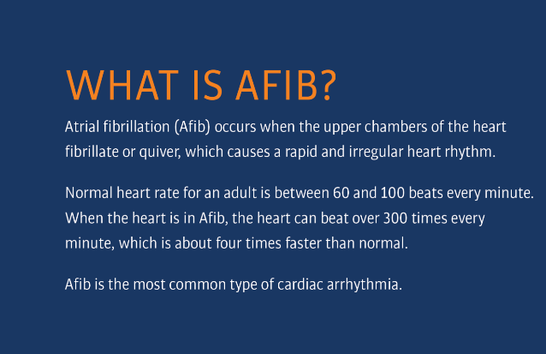
Definition of Afib

Slide 5
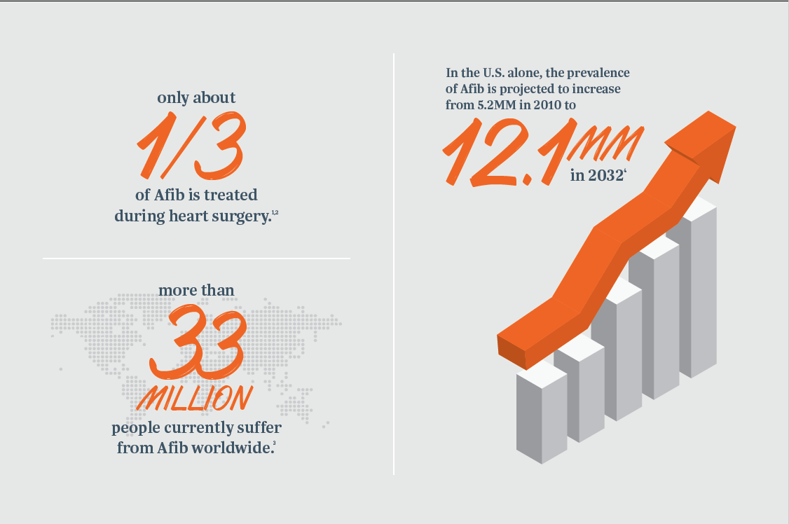
Why Treat Afib Surgically?
See Appendix A for References
Approximately 1/3 of Afib patients are paroxysmal, 2/3 persistent or long-standing persistent.⁵
Use of anti-arrhythmic drugs has shown to be ineffective to manage Afib in ~50% of patients.⁶

Slide 6
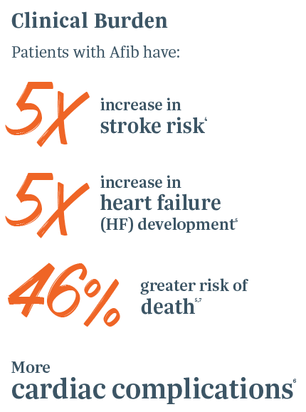
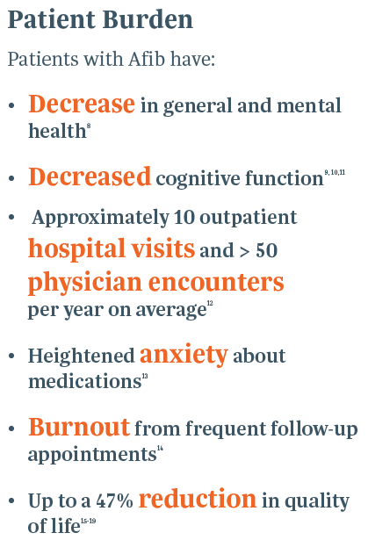
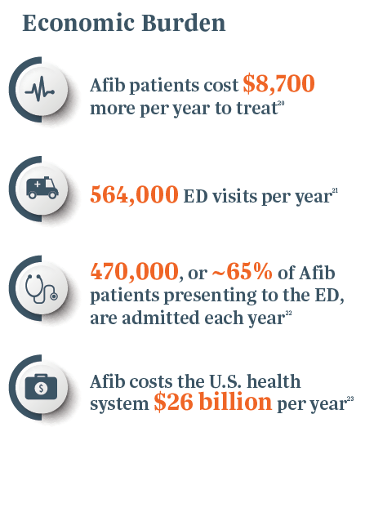
Afib is a Real Burden
See Appendix B for References

Slide 7
Severity of Afib Is Often Misunderstood
Sources: †Piccini, J.P. et al. (2014). Clinical course of atrial fibrillation in older adults: the importance of cardiovascular events beyond stroke. Eur Heart J, 35(4):250-6. *Adapted from: Howlader, N. et al. SEER Cancer Statistics Review, 1975-2010. National Cancer Institute. Bethesda, MD, https://seer.cancer.gov/archive/csr/1975_2010/, based on November 2012 SEER data submission, posted to the SEER website, April 2013.

Slide 8
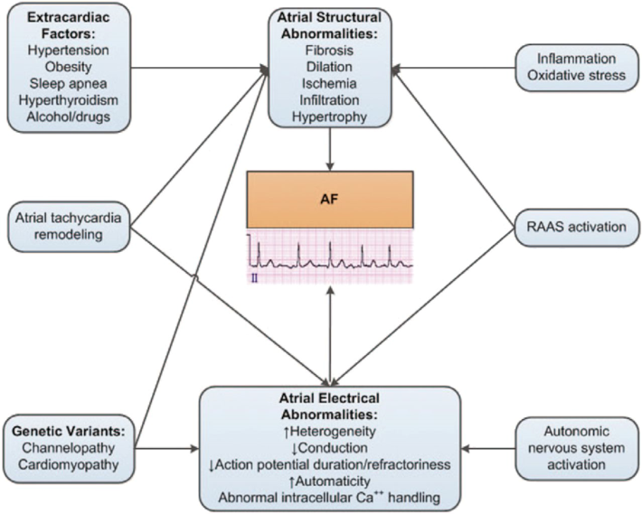
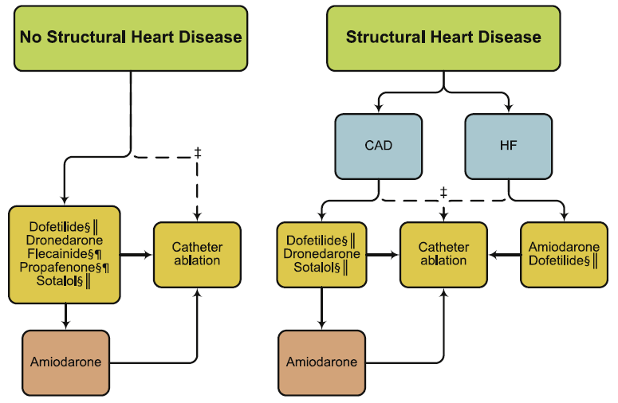
Managing Afib
Rate Control? Rhythm Control? Anticoagulation?
COMPLEX
Charts: January CT, Wann LS, Alpert JS, et al. : 2014 AHA/ACC/HRS Guideline for the Management of Patients With Atrial Fibrillation: Executive Summary : A Report of the American College of Cardiology/American Heart Association Task Force on Practice Guidelines and the Heart Rhythm Society. J Am Coll Cardiol. 2014;64(21):2246–80.

Slide 9
State of Afib
Despite advances in treatment, Afib still carries significant morbidity and mortality that stem from two major mechanisms¹:
AV Contractions / Hemodynamic Compromise
    Common Treatment – Antiarrhythmic Drugs (AADs)
    “The vast majority of patients who achieve stable sinus rhythm eventually can discontinue all antiarrhythmic agents.”²
Stasis of Blood in the Left Atrial Appendage (LAA) / Thromboemboli
    Common Treatment – Novel Oral Anticoagulants (NOACs)
    “Anticoagulation therapy is commonly continued until a stable sinus rhythm is documented by at least 24-hour Holter monitor off all antiarrhythmic drugs, often between 2 and 6 months postoperatively.”²
1 Badheka AO, Rathod A, Kizilbash MA, et al. Comparison of mortality and morbidity in patients with atrial fibrillation and heart failure with preserved versus decreased left ventricular ejection fraction. Am J Cardiol 2011;108:1283–8
2 Vinay Badhwar, et al. The Society of Thoracic Surgeons 2017 Clinical Practice Guidelines for the Surgical Treatment of Atrial Fibrillation. The Annals of Thoracic Surgery, 2017; 103: 329-41.

Slide 10
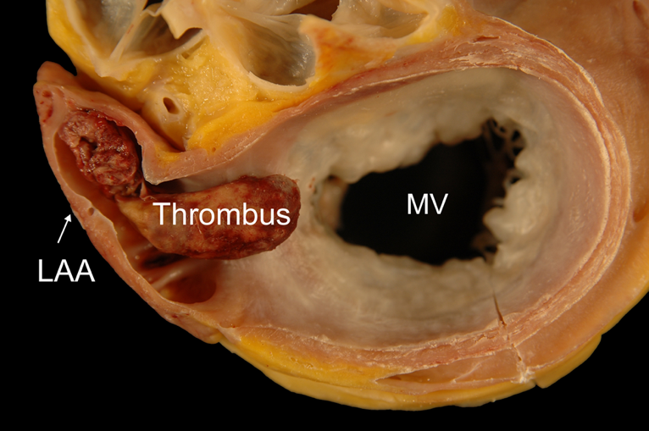
Left Atrial Appendage (LAA) and Afib
  In non-valvular Afib, >90% of stroke causing clots from the left atrium originate in the LAA.1
1 Blackshear J L, Odell J A. Appendage obliteration to reduce stroke in cardiac surgical patients with atrial fibrillation. Ann. Thorac. Surg. 1996 Feb;61 (2):755–9.

Slide 11
Warfarin / Novel Oral Anticoagulants Challenges (NOACs)
Treatment | Discontinuation Rate | Major Bleeding (rate/year)
Rivaroxaban1 | 24% | 3.6%
Apixaban2 | 25% | 2.1%
Dabigatran3 | 21% | 3.3%
Edoxaban4 ^{(60 mg /30 mg)} | 33% / 34% | 2.8% / 1.6%
Warfarin1-4 | 17% – 28% | 3.1% – 3.6%
1 Patel MR, Mahaffey KW, Garg J, Pan G, Singer DE, Hacke W, et al. Rivaroxaban versus warfarin in nonvalvular atrial fibrillation. N Engl J Med. Sep 8, 2011. pp. 883–891.
2 Granger CB, Alexander JH, McMurray JJ, Lopes RD, Hylek EM, Hanna M, et al. Apixaban versus warfarin in patients with atrial fibrillation. N Engl J Med. 2011 Sep 15;365(11):981–992.
3 Connolly SJ, Ezekowitz MD, Yusuf S, Eikelboom J, Oldgren J, Parekh A, et al. Dabigatran versus warfarin in patients with atrial fibrillation. N Engl J Med. 2009 Sep 17;361(12):1139–1151.
4 Giugliano RP, Ruff CT, Braunwald E, et al. Edoxaban versus warfarin in patients with atrial fibrillation. N Engl J Med 2013; 369:2093–2104.

Slide 12

State of Concomitant Atrial Fibrillation Surgery

Slide 13
State of Surgical Ablation for Afib
Surgical ablation has undergone many iterations since the success of the original 1987 Cox MAZE “Cut and Sew” technique.
Radiofrequency and cryoablation are the two ablative technologies that have prevailed to mimic the lines created by the “Cut and Sew” technique.
The following lesion sets are routinely used, and sometimes all of them are referred to as MAZE, though they have differing success rates:
    Pulmonary Vein Isolation (PVI)
    Box Lesion Set (BOX)
    Left Atrial Lesion Set (LAL)
    Bi-Atrial Lesion Set (MAZE)

Slide 14
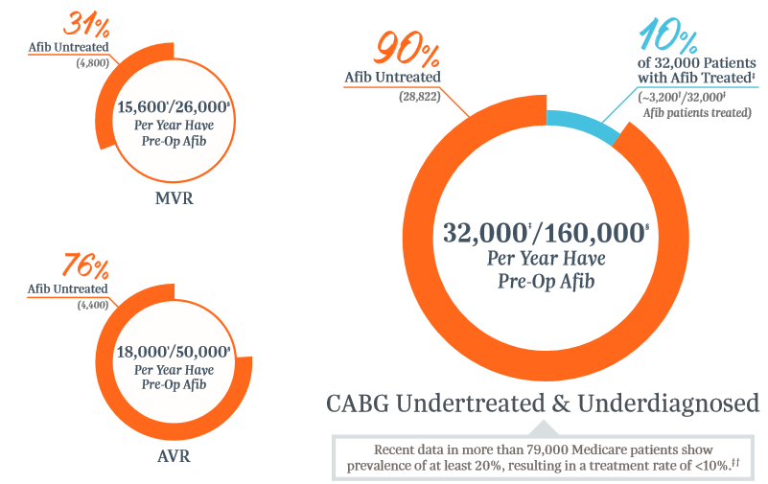
Afib is Surgically Undertreated
Sources:
1 Badhwar, V. et al. (2017). Surgical ablation of atrial fibrillation in the United States: trends and propensity matched outcomes. Ann of Thorac Surg, 104(2):493-500 Afib incidence pre-op by type of surgery. Reports incidence of Afib in MVR as 60% and AVR as 36%. § McCarthy, P.M. et al. (2019). Prevalence of atrial fibrillation before cardiac surgery and factors associated with concomitant ablation. J Thorac Cardiovasc Surg, PII: S0022-5223(19) 31361-3, DOI: 10.1016/J.JTCVS.2019.06.062. Showed 20% prevalence of Afib in CABG based on CMS data showing admission for Afib 3 years prior to CABG. † Braid-Forbes Health Research analysis of 2014 CMS SAF data: Annual Counts and Proportions of Atrial Fibrillation and Concomitant Surgical Atrial Ablation in US Cardiac Surgeries. Presented to AtriCure August 22, 2016. Showed 3,121 SA treatments during isolated CABG surgeries. Internal data on file. ‡ Society of Thoracic Surgery Database.

Slide 15
Why are patients undertreated?
Unaware of Class I level of recommendation from STS, 2017
Lack of screening protocols within a complex referral pathway
Concerns about adding risk to the primary procedure
    Prolonged pump and cross-clamp time
    Longer anesthesia
    Added complications
Not sure Afib treatment really offers advantages to patient
Perceived lack of consensus on whether to treat Afib
Lack of training and education in medical training
Internal data on file. Customer interviews and survey of 40 cardiothoracic surgeons October 2018.

Slide 16
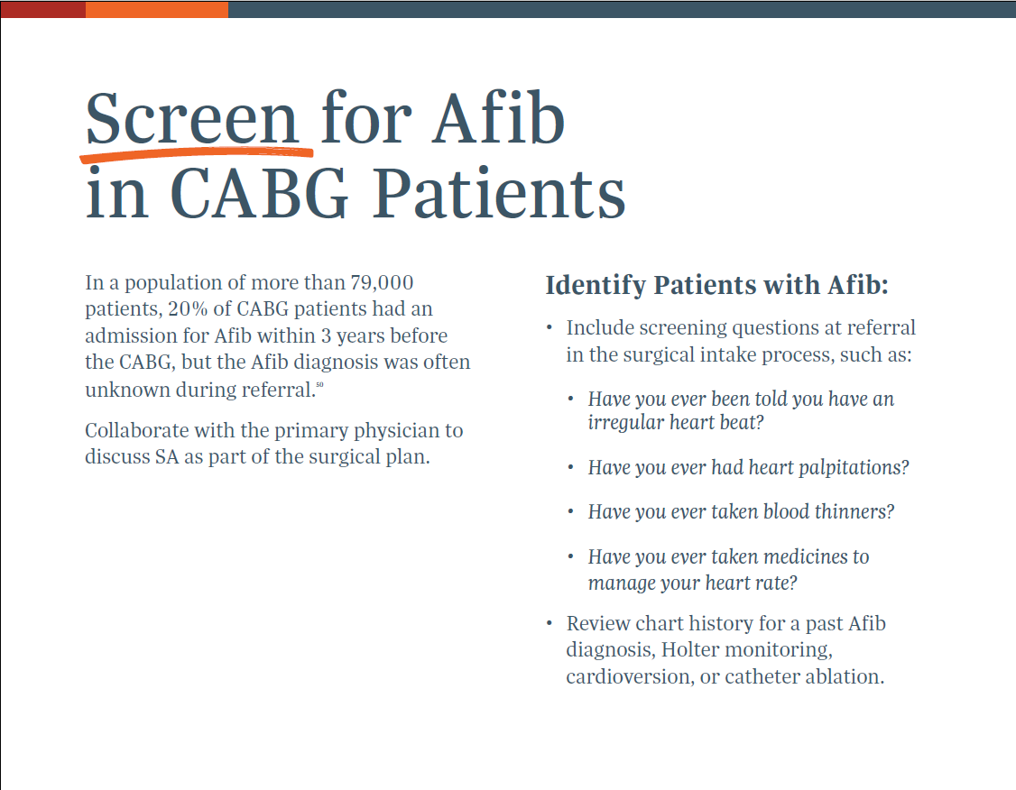
1 McCarthy, P. Afib incidence paper, submitted to Journal of Thoracic and Cardiovascular Surgery 2019. Pending review. Data sources: Braid-Forbes, M.J. Health Research, 2014 CMS SAF, August 2016. NIS for volume and Medicare to look back over 3 years before CABG and obtained diagnosis of Afib.
1

Slide 17
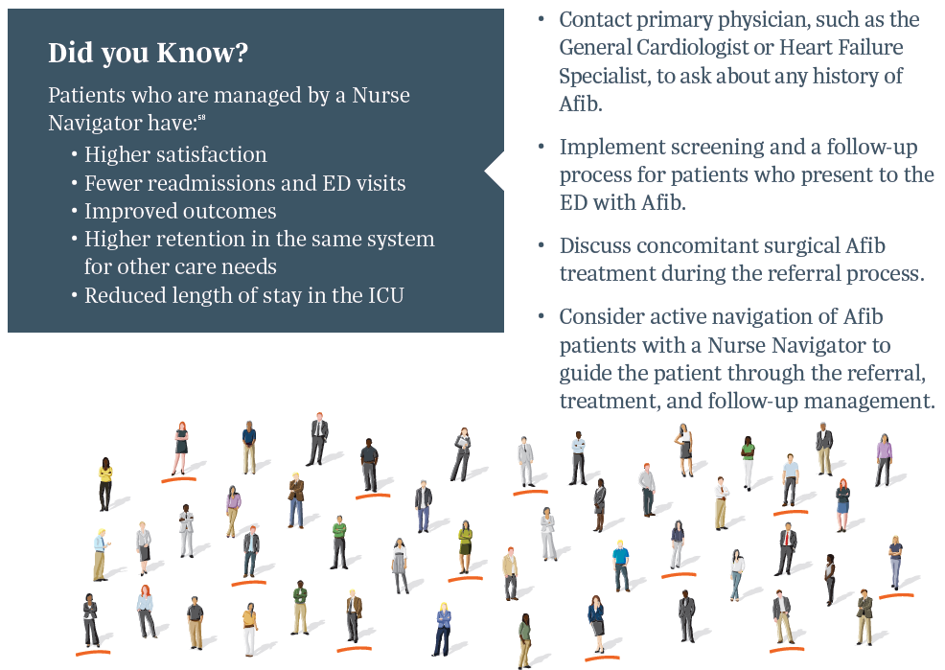
Manage Afib as a cardiomyopathy
Source: Data approved for use by The Advisory Board. Research, articles, and case studies.
American Nursing Association. (2012, June). The Value of Nursing Care Coordination: Executive Summary. Accessed April 2019. Retrieved from https://www.nursingworld.org/practice-policy/nursing-excellence/official-position-statements/id/care-coordination-and-registered-nurses-essential-role/
Health Catalyst. (2017). Data-Driven Approach to Improving Cardiovascular Care and Operations Leads to $75M in Improvements. Accessed April 2019. Retrieved from https://pdfs.semanticscholar.org/354d/b353eb085ae817f8a6e2f8de5721896f4c32.pdf

Slide 18

Atrial Fibrillation
Pathways and Goal of
MAZE Procedure

Slide 19
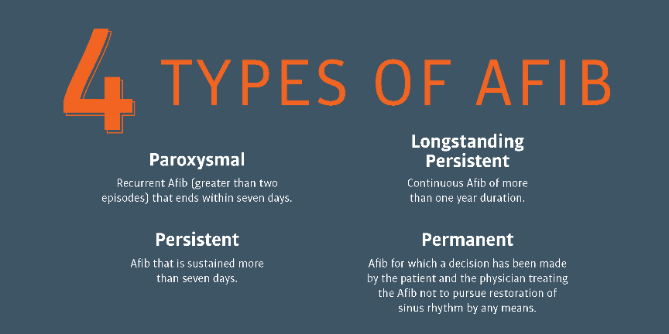
Types of Afib

Slide 20
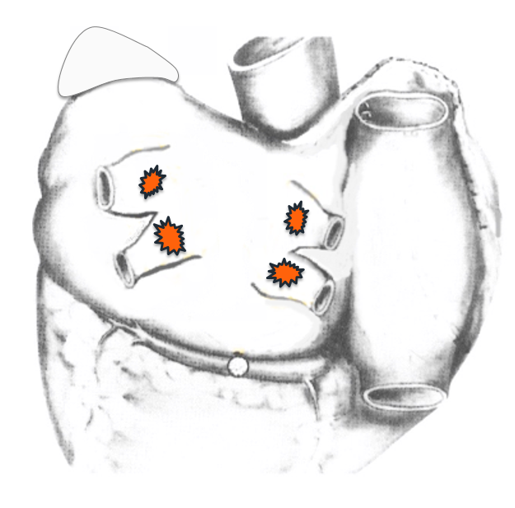
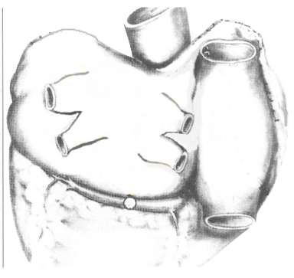
Mechanisms of Paroxysmal Afib (PAF)
The pulmonary veins are common Afib triggers in paroxysmal patients
Image: Courtesy of James L. Cox, MD

Slide 21
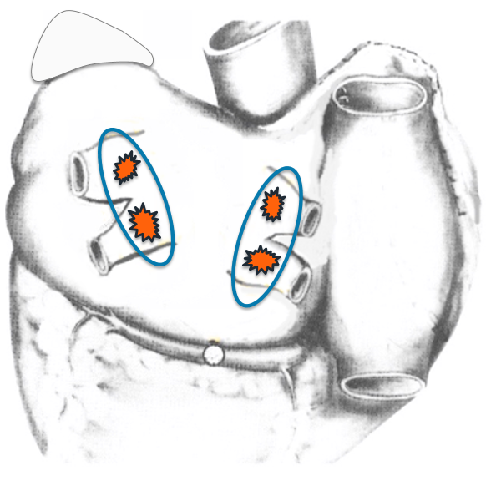
Ablation Treatment of PAF
Isolation of the pulmonary veins performed
Image: Courtesy of James L. Cox, MD

Slide 22
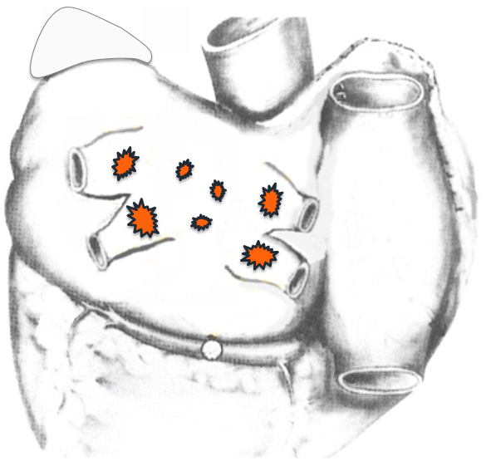
PAF ➔ Non-Paroxysmal Afib (nPAF)
The posterior left atrium becomes a common Afib trigger as patients move from paroxysmal to non-paroxysmal Afib
Image: Courtesy of James L. Cox, MD

Slide 23
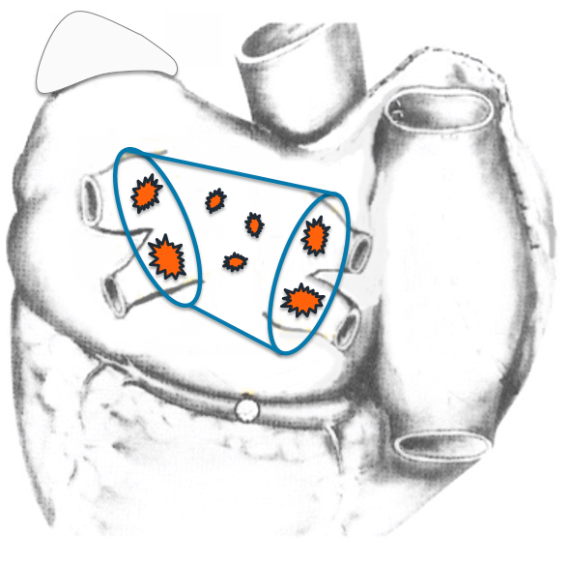
Ablation Treatment PAF ➔ nPAF
Isolation of the pulmonary veins and posterior left atrium performed
Image: Courtesy of James L. Cox, MD

Slide 24
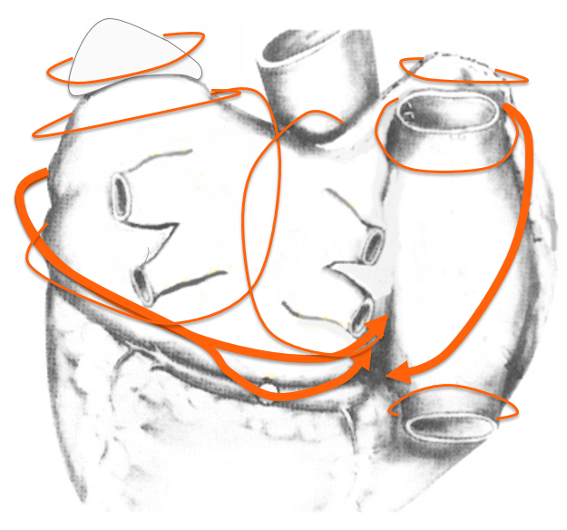
Mechanisms of nPAF Afib
Maco-reentrant circuits are common Afib triggers in non-paroxysmal patients
Image: Courtesy of James L. Cox, MD

Slide 25
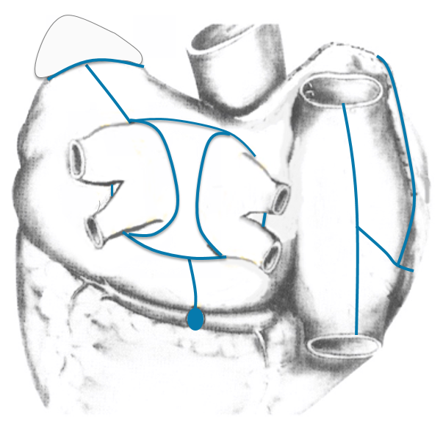
MAZE IV Ablation Treatment of nPAF
MAZE IV lesion set performed with radiofrequency and cryoablation technologies
Image: Courtesy of James L. Cox, MD

Slide 26
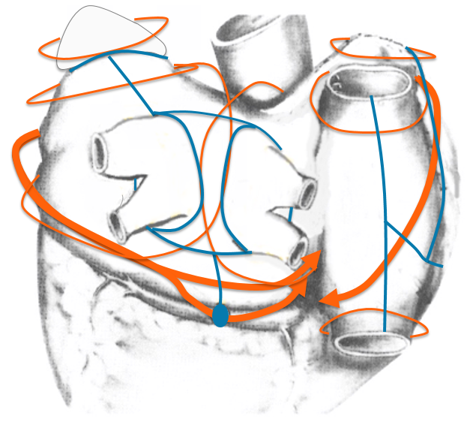
MAZE IV Ablation Treatment of nPAF
MAZE IV lesion set blocks all macro-re-entrant Afib triggers
Image: Courtesy of James L. Cox, MD

Slide 27

Surgical Options for Treating
Atrial Fibrillation

Slide 28
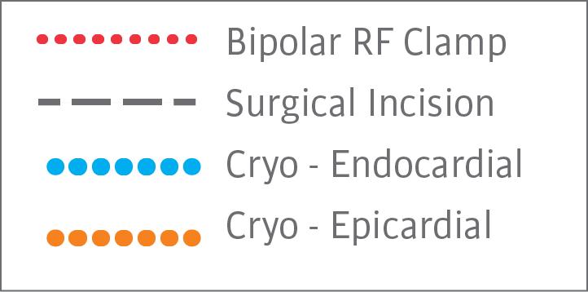
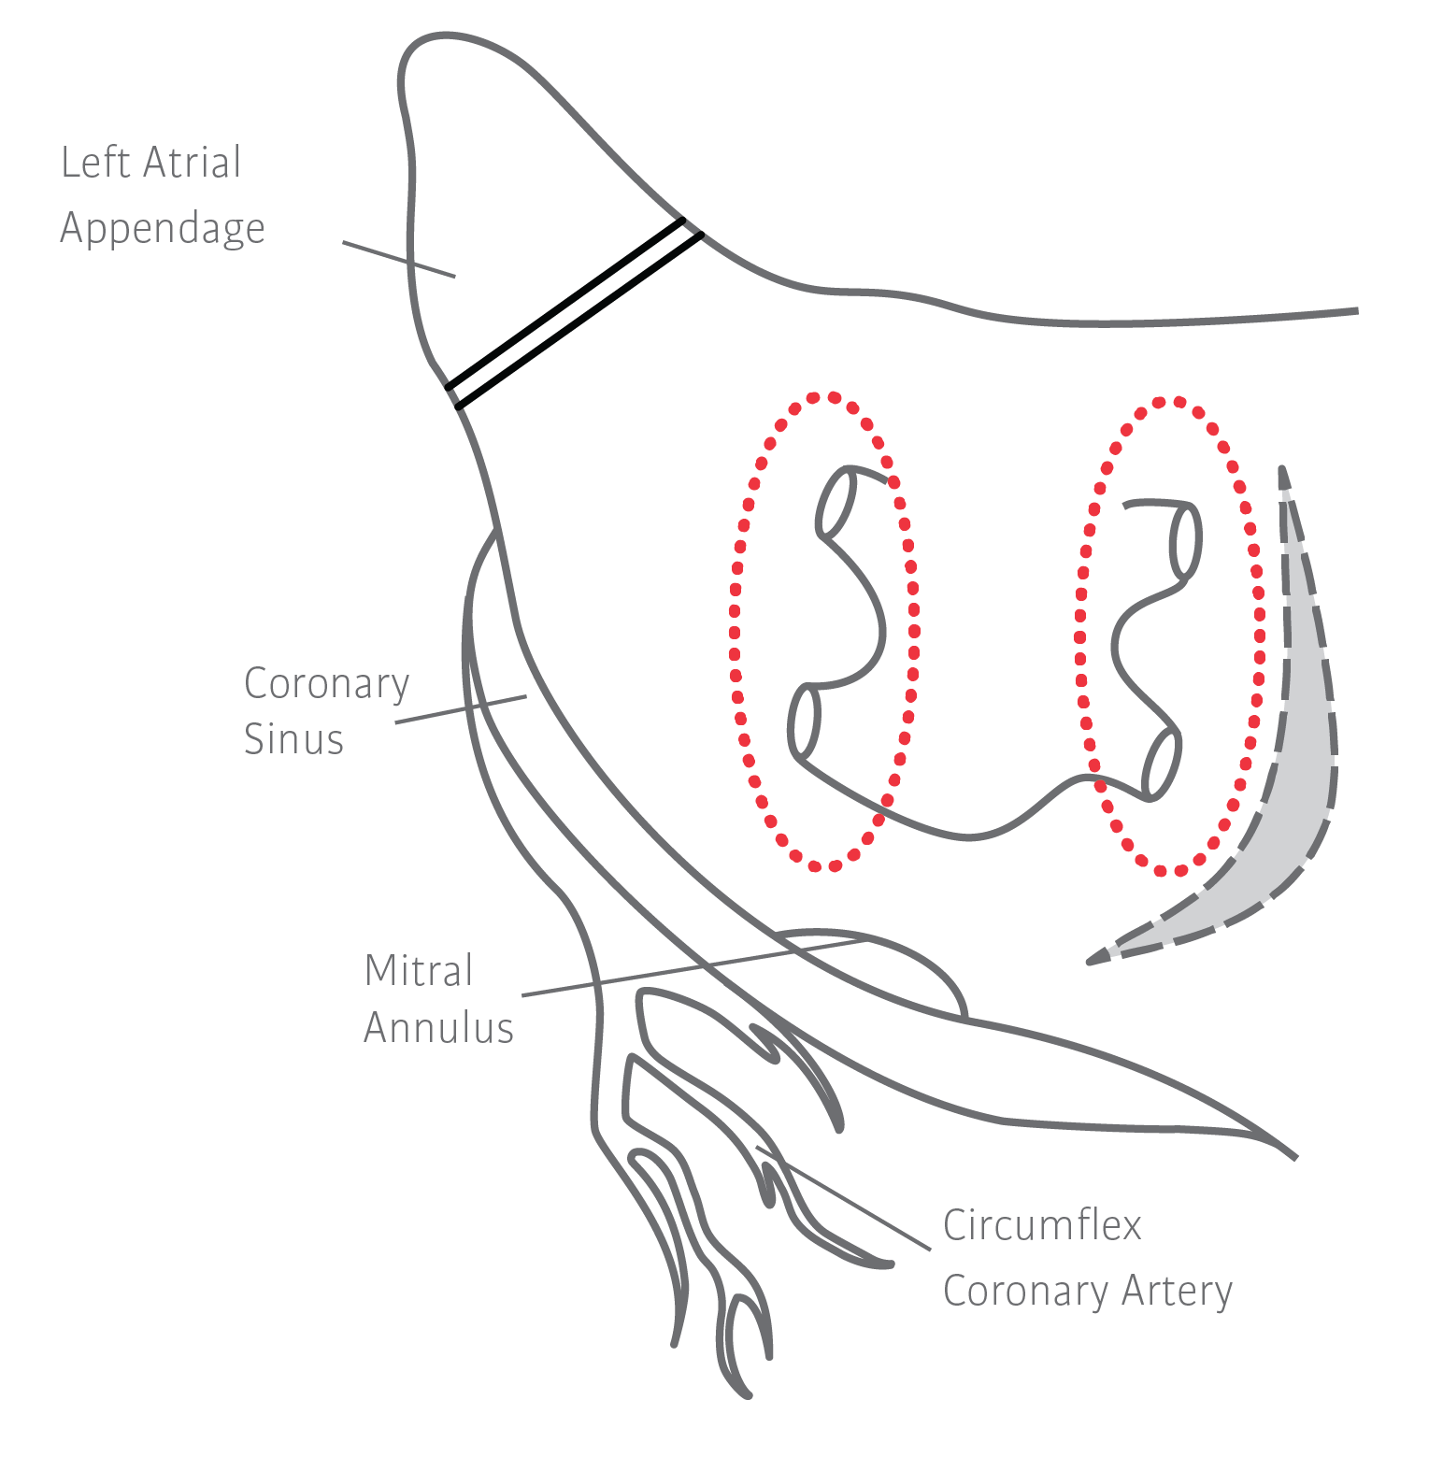
Pulmonary Vein Isolation and LAAM
PVI Alone:
~60% Afib Free1,2 (nPAF)
1 Gillinov, A. M., Gelijns, A. C., Parides, M. K., DeRose Jr, J. J., Moskowitz, A. J., Voisine, P., … & Acker, M. A. (2015). Surgical ablation of atrial fibrillation during mitral-valve surgery. New England Journal of Medicine, 372(15), 1399-1409.
2 Badhwar, V., Rankin, J. S., Damiano, R. J., Gillinov, A. M., Bakaeen, F. G., Edgerton, J. R., … & Thourani, V. H. (2017). The Society of Thoracic Surgeons 2017 clinical practice guidelines for the surgical treatment of atrial fibrillation. The Annals of thoracic surgery, 103(1), 329-341.
Notes:
“Isolation of the PVs remains the main target of interventional therapy for paroxysmal Afib. Yet, because of the requirement for repeat procedures due to a high rate of recurrence of PV conduction, further improvement of this treatment is needed.”¹
Ouyang “PAF Catheter Ablation”¹
PVI: 46.6% Afib free following 1 procedure (5 yr)
Ouyang “nPAF Catheter Ablation”²
PVI: 33.7% Afib free (19 ± 11 mths)
PVI: 67.8% Afib free following (1.7 ± 0.8 procedures)

Slide 29
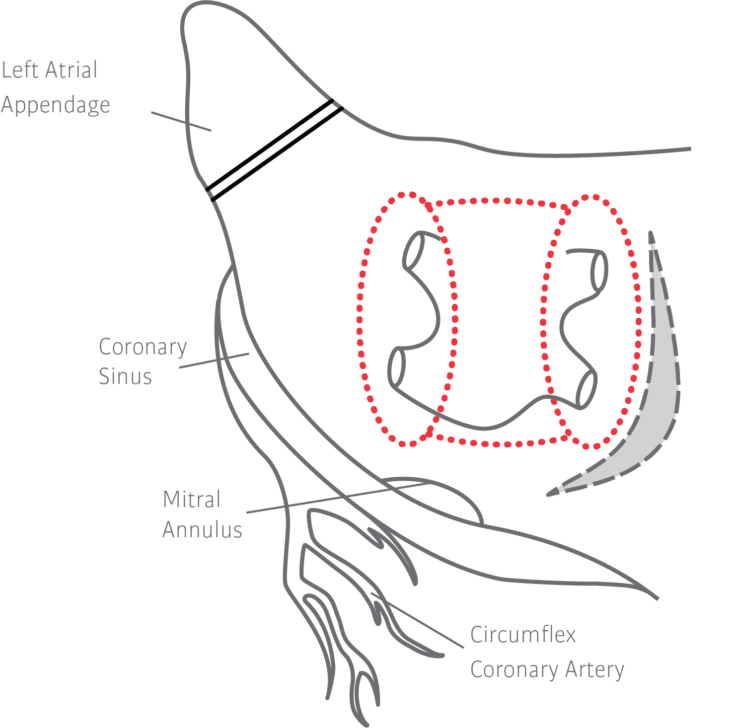
Box Lesion Set and LAAM
PVI + Box:
~55-70% Afib
Free1,2 (nPAF)
1 Voeller, R. K., Bailey, M. S., Zierer, A., Lall, S. C., Sakamoto, S. I., Aubuchon, K., … & Moon, M. R. (2008). Isolating the entire posterior left atrium improves surgical outcomes after the Cox maze procedure. The Journal of thoracic and cardiovascular surgery, 135(4), 870-877.
2 Gillinov, A. M., Bhavani, S., Blackstone, E. H., Rajeswaran, J., Svensson, L. G., Navia, J. L., ... & McCarthy, P. M. (2006). Surgery for permanent atrial fibrillation: impact of patient factors and lesion set. The Annals of thoracic surgery, 82(2), 502-514.
Notes:
“Probably is a reflection of the posterior left atrium being an important source for the triggers responsible for the initiation and the drivers required for the maintenance of Afib.” –J Cox
Damiano “Isolating Post LA”¹
PVI+Floor: 61% Afib free (1yr)
PVI+Box: 83% Afib free (1yr)

Slide 30
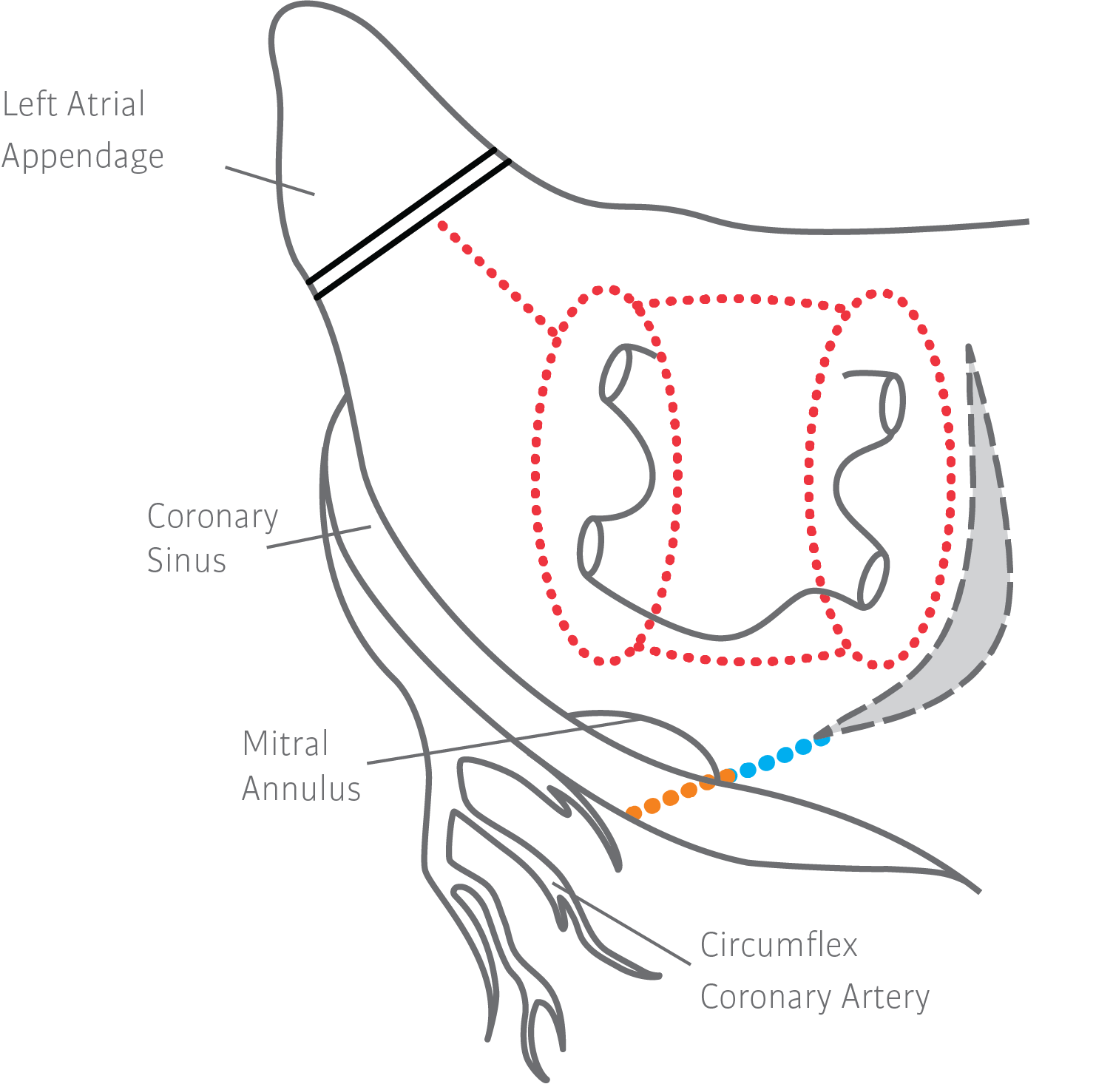
Left Atrial Lesion Set and LAAM
LALS:
~73-86% Afib
Free1,2 (nPAF)
~20% fewer
Atrial Flutter3
1 Barnett, S. D., & Ad, N. (2006). Surgical ablation as treatment for the elimination of atrial fibrillation: a meta-analysis. The Journal of thoracic and cardiovascular surgery, 131(5), 1029-1035.
2 Ad, N., Holmes, S. D., Lamont, D., & Shuman, D. J. (2017). Left-Sided Surgical Ablation for Patients With Atrial Fibrillation Who Are Undergoing Concomitant Cardiac Surgical Procedures. The Annals of thoracic surgery, 103(1), 58-65.
3 Cox JL, Ad N. The importance of cryoablation of the coronary sinus during the Maze procedure. Semin Thorac Cardiovasc Surg 2000;12:20-4.
Notes:
“Most commonly results in post-operative peri-mitral flutter. Cannot identify peri-operatively who will develop this post-operatively.” –J Cox
Cox/Ad Seminar¹
-5 of 6 pts w/recurrent atrial flutter by conduction through CS
-With CS/MI: 1% atrial flutter
Kawaguchi Early Experience¹
-No CS/MI: 20% atrial flutter

Slide 31
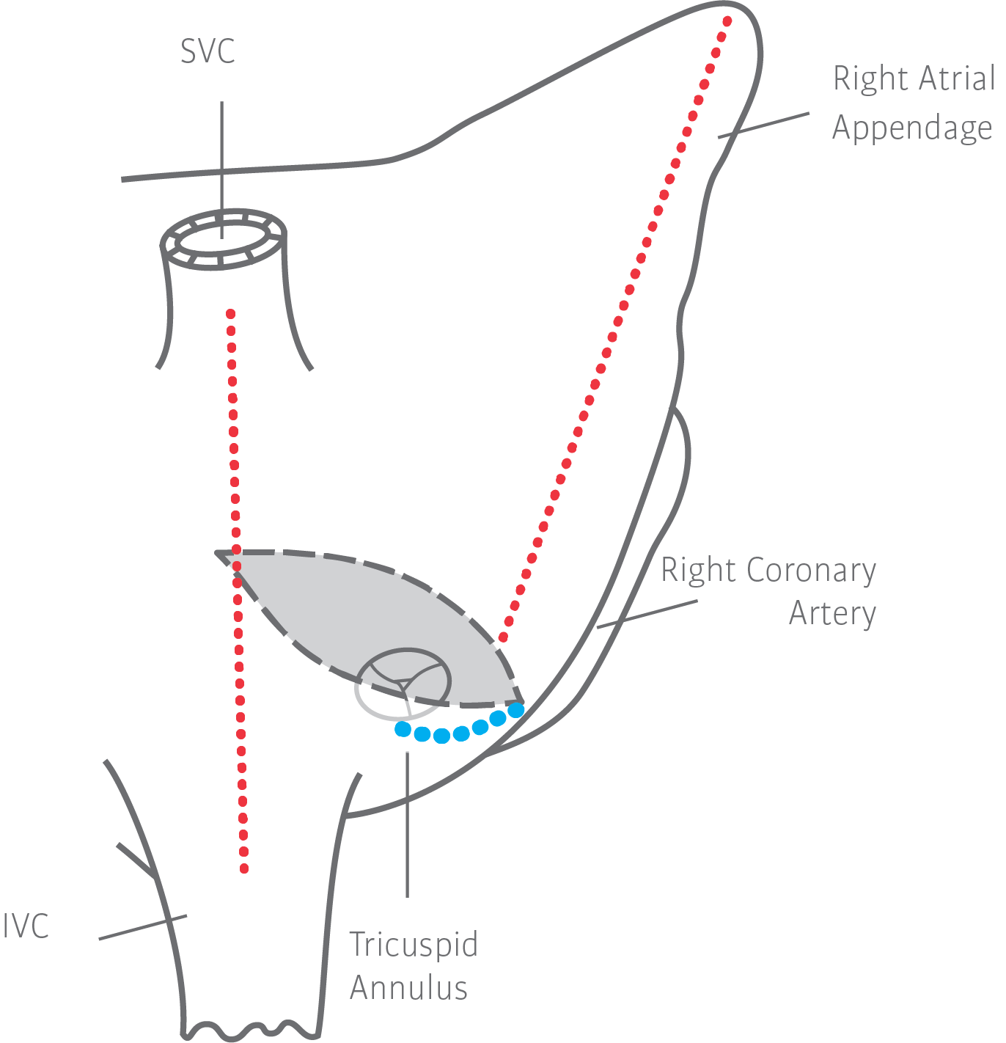
MAZE IV and LAAM
MAZE IV:
~80-90%
Afib Free1,2,3
(nPAF)
1 Gaynor, S. L., Schuessler, R. B., Bailey, M. S., Ishii, Y., Boineau, J. P., Gleva, M. J., … & Damiano, R. J. (2005). Surgical treatment of atrial fibrillation: predictors of late recurrence. The Journal of thoracic and cardiovascular surgery, 129(1), 104-111.
2 Weimar, T., Bailey, M. S., Watanabe, Y., Marin, D., Maniar, H. S., Schuessler, R. B., & Damiano, R. J. (2011). The Cox-maze IV procedure for lone atrial fibrillation: a single center experience in 100 consecutive patients. Journal of interventional cardiac electrophysiology, 31(1), 47-54.
3 Schill, M. R., Musharbash, F. N., Hansalia, V., Greenberg, J. W., Melby, S. J., Maniar, H. S., ... & Damiano, R. J. (2017). Late results of the Cox-maze IV procedure in patients undergoing coronary artery bypass grafting. The Journal of thoracic and cardiovascular surgery, 153(5), 1087-1094.
Notes:
ABLATE Trial¹
MAZE:84% Afib free (6mo)
MAZE: 76% Afib free, off AAD (6mo)
2006 Ad Meta-Analysis²
MAZE: 88.9% Afib free (1yr)
Damiano Late Recurrence³
MAZE: 90%+ Afib free (1yr)
Weimer Late Recurrence⁴
MAZE: 90% Afib free (2yr)
MAZE: 84% Afib free, off AAD (2yr)

Slide 32
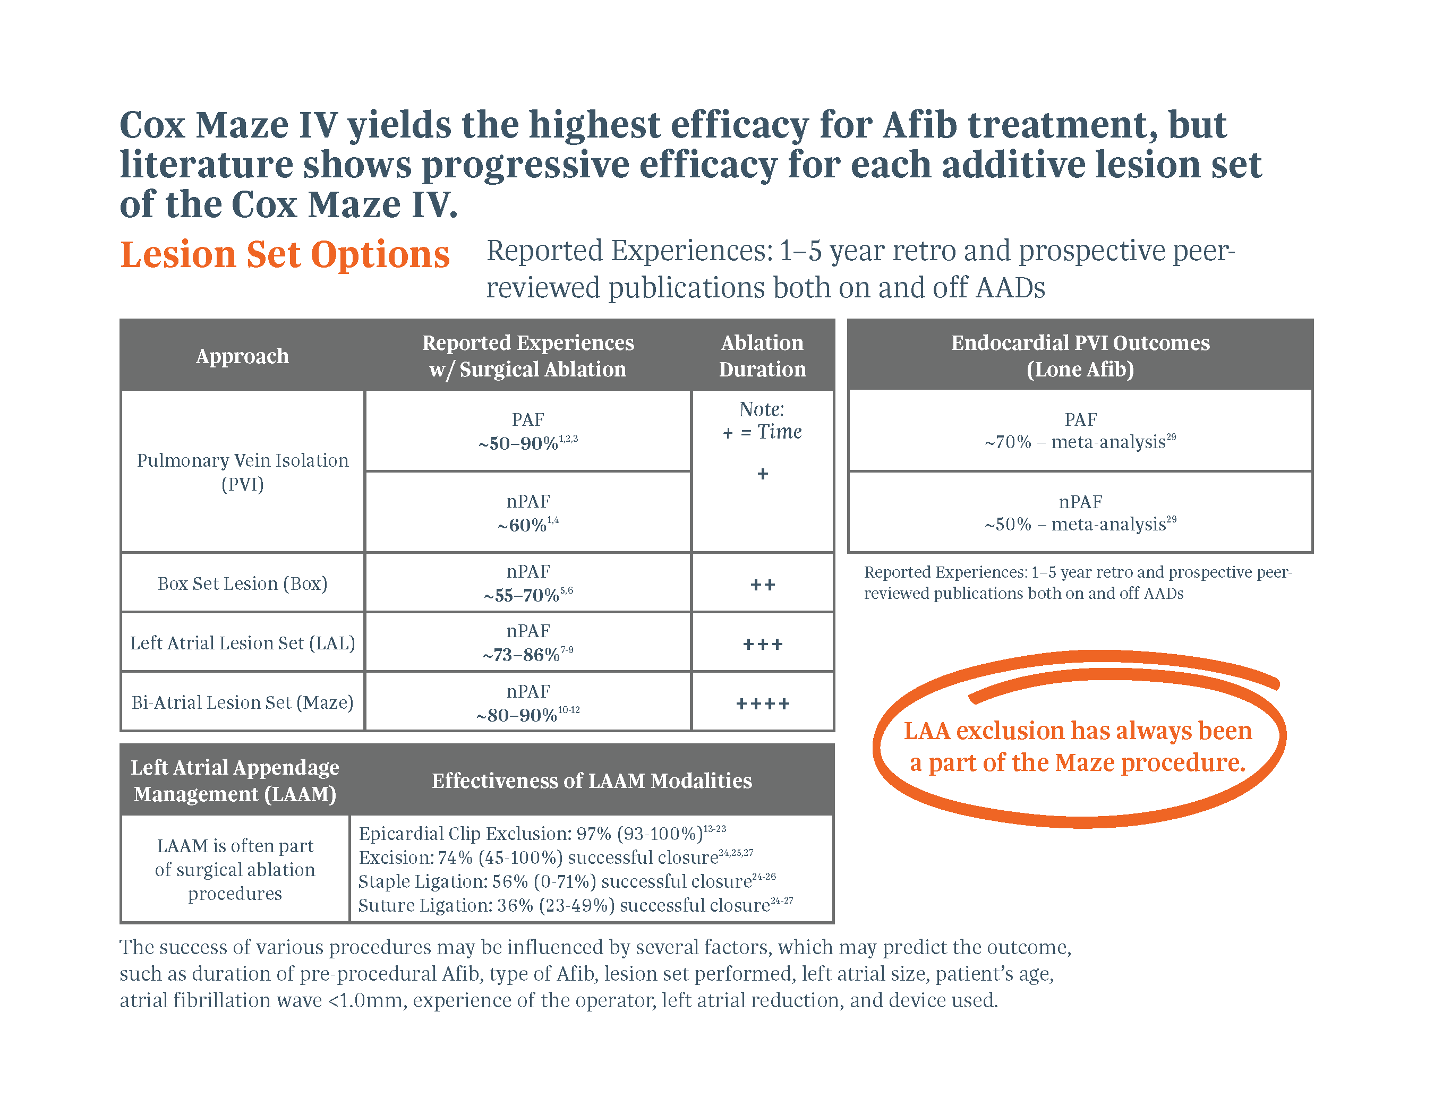
Do Something
AADs: antiarrythmic drugs
References Available in Appendix D.
Individual results may vary. Please consult with your physician regarding your condition and appropriate medical treatment. The success of various procedures may be influenced by several factors, which may predict the outcome. Duration of pre-procedural Afib, type of Afib, lesion set performed, left atrial size, patient’s age, atrial fibrillation wave <1.0mm, experience of the operator, left atrial reduction, and device used.

Slide 33

Clinical Outcomes of Concomitant Surgical Ablation
PE-US-0757-0521-G

Slide 34
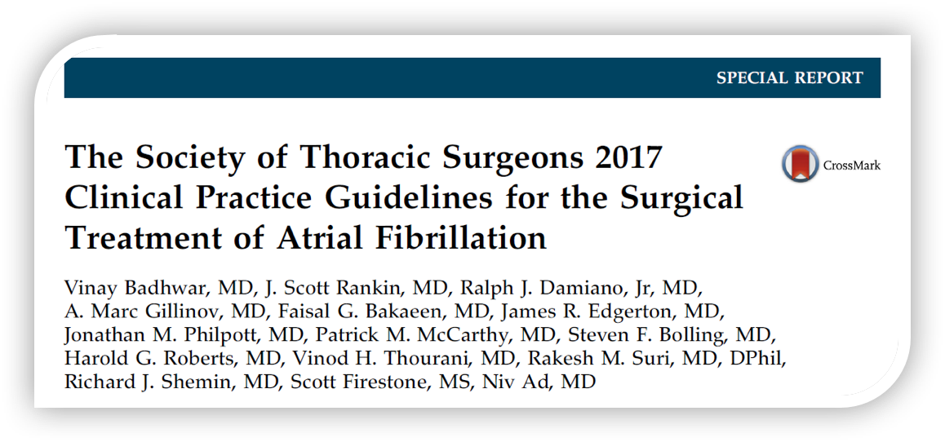
Safety / Risk
Class I Recommendation:
“Surgical ablation for AF can be performed
without additional risk of operative mortality
or major morbidity…”1
1 Vinay Badhwar, J. Scott Rankin, Ralph J. Damiano, A. Marc Gillinov, Faisal G. Bakaeen, James R. Edgerton, Jonathan M. Philpott, Patrick M. McCarthy, Steven F. Bolling, Harold G. Roberts, Vinod H. Thourani, Rakesh M. Suri, Richard J. Shemin, Scott Firestone, Niv Ad. The Society of Thoracic Surgeons 2017 Clinical Practice Guidelines for the Surgical Treatment of Atrial Fibrillation. The Annals of Thoracic Surgery, 2017; 103: 329-41.

Slide 35
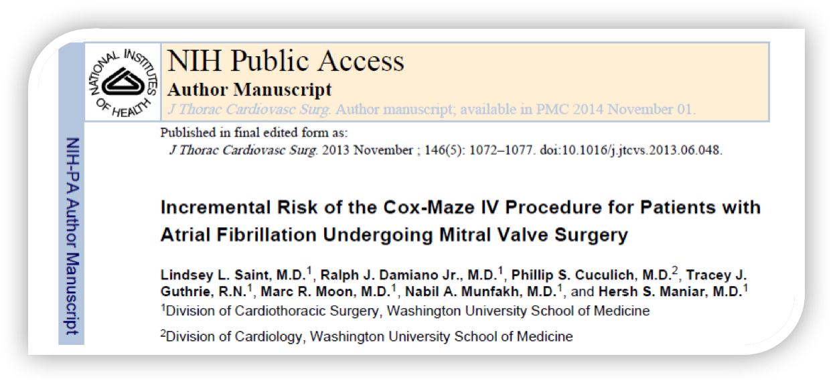
Safety / Risk
“The addition of the Cox Maze IV procedure did not significantly affect the procedural mortality.”1
1 Saint LL, Damiano RJ, Jr, Cuculich PS, et al. Incremental risk of the Cox-maze IV procedure for patients with atrial fibrillation undergoing mitral valve surgery. J Thorac Cardiovasc Surg. 2012 in press.

Slide 36
Potential to Eliminate Anti-Arrhythmic Drugs?
“Most patients are administered perioperative class I or III antiarrhythmic drugs, such as amiodarone, and these are often continued for 2 to 3 months after SA. The vast majority of patients who achieve stable sinus rhythm eventually can discontinue all antiarrhythmic agents .…”1
1 Vinay Badhwar, J. Scott Rankin, Ralph J. Damiano, A. Marc Gillinov, Faisal G. Bakaeen, James R. Edgerton, Jonathan M. Philpott, Patrick M. McCarthy, Steven F. Bolling, Harold G. Roberts, Vinod H. Thourani, Rakesh M. Suri, Richard J. Shemin, Scott Firestone, Niv Ad. The Society of Thoracic Surgeons 2017 Clinical Practice Guidelines for the Surgical Treatment of Atrial Fibrillation. The Annals of Thoracic Surgery, 2017; 103: 329-41.

Slide 37
Potential to Eliminate NOACs?
“After surgical ablation for AF, full anticoagulation therapy is common and reasonable until durable rhythm restoration is established, provided the patient otherwise meets criteria for the safe administration of systemic anticoagulant agents. Anticoagulation therapy is commonly continued until a stable sinus rhythm is documented by at least a 24-hour Holter monitor off all antiarrhythmic drugs, often between 2 and 6 months postoperatively. It is also common practice to obtain an echocardiogram before discontinuing anticoagulation to ensure adequate LA emptying by the absence of spontaneous LA echocardiography contrast.”1
1 Vinay Badhwar, J. Scott Rankin, Ralph J. Damiano, A. Marc Gillinov, Faisal G. Bakaeen, James R. Edgerton, Jonathan M. Philpott, Patrick M. McCarthy, Steven F. Bolling, Harold G. Roberts, Vinod H. Thourani, Rakesh M. Suri, Richard J. Shemin, Scott Firestone, Niv Ad. The Society of Thoracic Surgeons 2017 Clinical Practice Guidelines for the Surgical Treatment of Atrial Fibrillation. The Annals of Thoracic Surgery, 2017; 103: 329-41.

Slide 38
Potential Benefits of Surgical Ablation
The following slides contain studies demonstrating the potential benefits of surgical ablation.
All manuscripts were selected from peer-reviewed journals in cardiothoracic surgery.

Slide 39
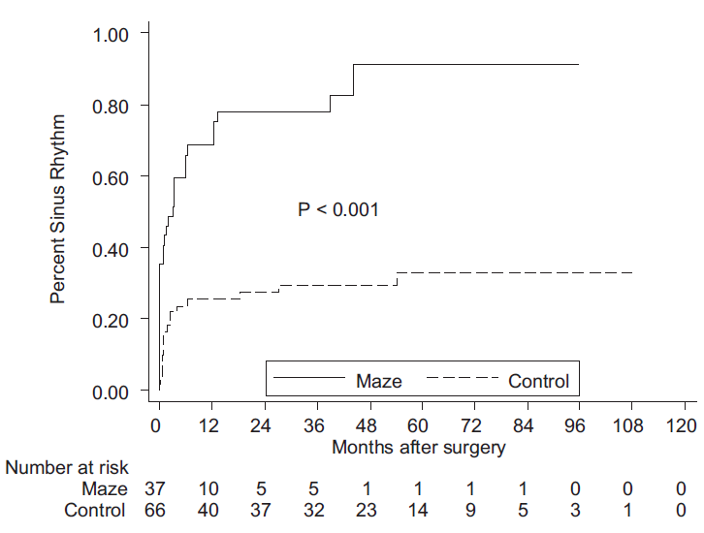
#1 Restoration of Normal Sinus Rhythm1
37pts
Afib Treated
(nPAF)
66pts
Afib Not Treated
(nPAF)
1 Louagie Y, Buche M, Eucher P, Schoevaerdts JC, Gerard M, Jamart J, et al. Improved patient survival with concomitant Cox Maze III procedure compared with heart surgery alone. Ann Thorac Surg. 2009;87:440–6.

Slide 40
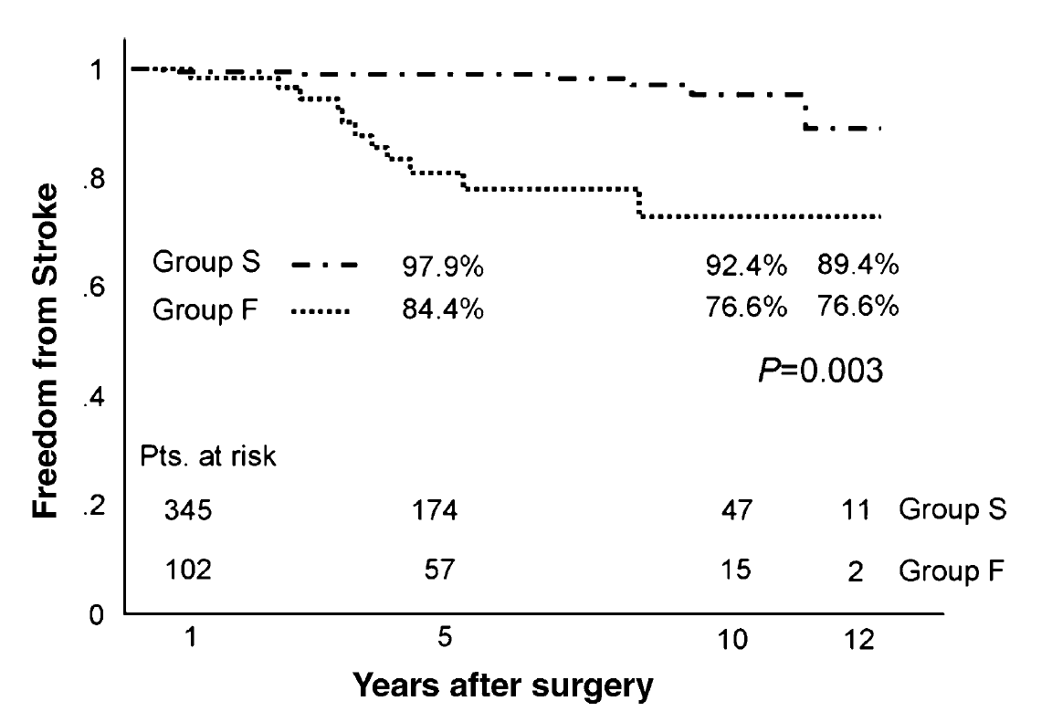
#2 Freedom from Long-Term Strokes1
394pts
Afib Treated
(In Sinus Rhythm)
116pts
Afib Treated
(Not in Sinus Rhythm)
Note: A stroke was defined as a neurological deficit concomitant with ischemic image findings on a computed tomography or a magnetic resonance imaging
1 Itoh A, Kobayashi J, Bando K, Niwaya K, Tagusari O, Nakajima H. et al. The impact of mitral valve surgery combined with maze procedure. Eur J Cardiothorac Surg. 2006;29(6):1030–5.

Slide 41
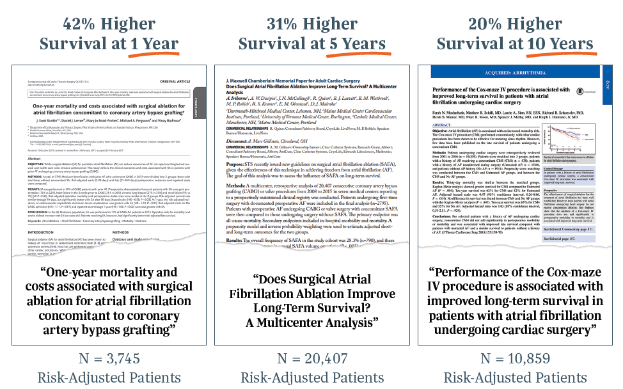
#3 Reduction in All-Cause Mortality

Slide 42
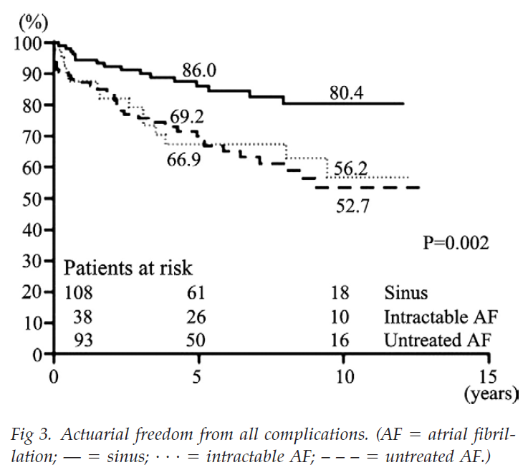
#4 Decrease in All Cardiac Complications1
108pts
Afib Treated
(In Sinus Rhythm)
136pts
Intractable or Afib
Not Treated
1 Fukunaga et al. (2008) Fukunaga S, Hori H, Ueda T, Takagi K, Tayama E, Aoyagi S. Effect of surgery for atrial fibrillation associated with mitral valve disease. The Annals of Thoracic Surgery. 2008;86(4):1212–1217.

Slide 43
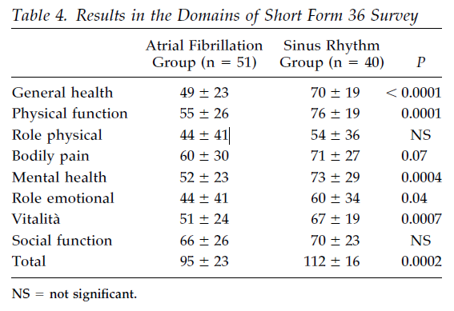
#5 An Improved Quality of Life1
1 Forlani S, De Paulis R, Guerrieri Wolf L, Greco R, Polisca P, Moscarelli M, et al. Conversion to sinus rhythm by ablation improves quality of life in patients submitted to mitral valve surgery. Ann Thorac Surg. 2006;81(3):863–7.

Slide 44

Societal Guidelines for Concomitant
Atrial Fibrillation Surgery

Slide 45
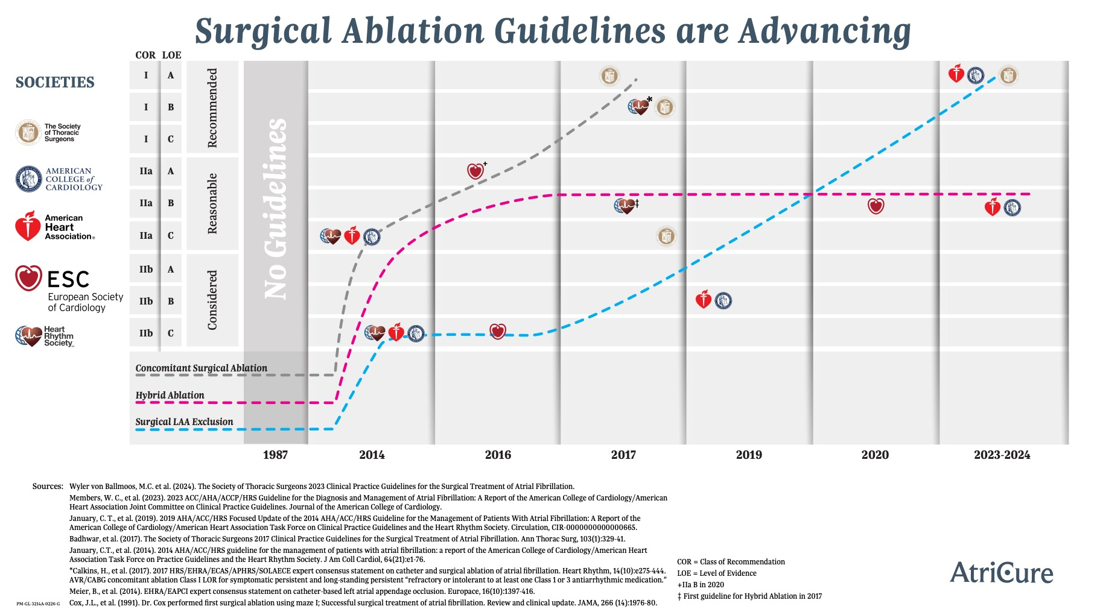
Concomitant Class I Recommendation
Sources Available in Appendix E. COR = Class of Recommendation LOE = Level of Evidence

Slide 46







General Societal Guidelines
Class I or II Recommendations
“It is advisable that all patients with
documented Afib referred for other cardiac surgeries undergo a….procedure for Afib…”
Heart Rhythm Society
American College of Cardiology
American Heart Association
Society of Thoracic Surgeons
European Heart Rhythm Association
European Cardiac Arrhythmia Society
European Society of Cardiothoracic Surgery

Slide 47

2017 HRS/EHRA/ECAS/APHRS/SOLAECE1
Class of Recommendation – I
Surgical ablation of AF is RECOMMENDED for paroxysmal, persistent, and long-standing persistent patients who are symptomatic AF refractory or intolerant to at least one Class 1 or 3 antiarrhythmic medication during concomitant open procedures (such as MVR). (Class I, Level B nonrandomized)
Surgical ablation of AF is RECOMMENDED for paroxysmal, persistent, and long-standing persistent patients who are symptomatic AF prior to initiation of antiarrhythmic therapy with a class 1 or 3 antiarrhythmic medication during concomitant open procedures (such as MVR). (Class I, Level B nonrandomized)
Surgical ablation of AF is RECOMMENDED for paroxysmal, persistent, and long-standing persistent patients who are symptomatic AF refractory or intolerant to at least one Class 1 or 3 antiarrhythmic medication during concomitant closed procedures (such as CABG and AVR). (Class I, Level B nonrandomized)
¹ Calkins H, Hindricks G, Cappato R, Kim Y-H, Saad EB, Aguinaga L, Akar JG, Badhwar V, Brugada J, Camm J, Chen P-S, Chen S-A, Chung MK, Nielsen JC, Curtis AB, Davies DW, Day JD, d’Avila A, (Natasja) de Groot NMS, Di Biase L, Duytschaever M, Edgerton JR, Ellenbogen KA, Ellinor PT, Ernst S, Fenelon G, Gerstenfeld EP, Haines DE, Haissaguerre M, Helm RH, Hylek E, Jackman WM, Jalife J, Kalman JM, Kautzner J, Kottkamp H, Kuck KH, Kumagai K, Lee R, Lewalter T, Lindsay BD, Macle L, Mansour M, Marchlinski FE, Michaud GF, Nakagawa H, Natale A, Nattel S, Okumura K, Packer D, Pokushalov E, Reynolds MR, Sanders P, Scanavacca M, Schilling R, Tondo C, Tsao H-M, Verma A, Wilber DJ, Yamane T, 2017 HRS/EHRA/ECAS/APHRS/SOLAECE Expert Consensus Statement on Catheter and Surgical Ablation of Atrial Fibrillation, Heart Rhythm (2017), doi: 10.1016/j.hrthm.2017.05.012.

Slide 48
2017 HRS/EHRA/ECAS/APHRS/SOLAECE1
Class of Recommendation – II
Surgical ablation of AF is REASONABLE for paroxysmal, persistent, and long-standing persistent patients who are symptomatic AF prior to initiation of antiarrhythmic therapy with a class 1 or 3 antiarrhythmic medication during concomitant closed procedures (such as CABG and AVR). (Class IIA, Level B nonrandomized)
Stand-Alone and Hybrid surgical ablation of AF is REASONABLE for persistent, and long-standing persistent patients who are symptomatic AF refractory or intolerant to at least one Class 1 or 3 antiarrhythmic medication and have failed one or more attempts at catheter ablation or prefer a surgical approach. (Class IIA, Level B nonrandomized)
Stand-Alone and Hybrid surgical ablation of AF CAN BE CONSIDERED for paroxysmal patients who are symptomatic AF refractory or intolerant to at least one Class 1 or 3 antiarrhythmic medication and have failed one or more attempts at catheter ablation or prefer a surgical approach. (Class IIB, Level B nonrandomized)
1 Calkins H, Hindricks G, Cappato R, Kim Y-H, Saad EB, Aguinaga L, Akar JG, Badhwar V, Brugada J, Camm J, Chen P-S, Chen S-A, Chung MK, Nielsen JC, Curtis AB, Davies DW, Day JD, d’Avila A, (Natasja) de Groot NMS, Di Biase L, Duytschaever M, Edgerton JR, Ellenbogen KA, Ellinor PT, Ernst S, Fenelon G, Gerstenfeld EP, Haines DE, Haissaguerre M, Helm RH, Hylek E, Jackman WM, Jalife J, Kalman JM, Kautzner J, Kottkamp H, Kuck KH, Kumagai K, Lee R, Lewalter T, Lindsay BD, Macle L, Mansour M, Marchlinski FE, Michaud GF, Nakagawa H, Natale A, Nattel S, Okumura K, Packer D, Pokushalov E, Reynolds MR, Sanders P, Scanavacca M, Schilling R, Tondo C, Tsao H-M, Verma A, Wilber DJ, Yamane T, 2017 HRS/EHRA/ECAS/APHRS/SOLAECE Expert Consensus Statement on Catheter and Surgical Ablation of Atrial Fibrillation, Heart Rhythm (2017), doi: 10.1016/j.hrthm.2017.05.012.

Slide 49
2017 STS1
Class of Recommendation – I
Surgical ablation for AF can be performed without additional risk of operative mortality or major morbidity, and is RECOMMENDED at the time of concomitant mitral operations to restore sinus rhythm. (Class I, Level A)
Surgical ablation for AF can be performed without additional operative risk of mortality or major morbidity, and is RECOMMENDED at the time of concomitant isolated aortic valve replacement, isolated coronary artery bypass graft surgery, and aortic valve replacement plus coronary artery bypass graft operations to restore sinus rhythm. (Class I, Level B nonrandomized)
In the treatment of AF, multidisciplinary heart team assessment, treatment planning, and long-term follow-up can be USEFUL AND BENEFICIAL to optimize patient outcomes. (Class I, Level C expert opinion)
1 Vinay Badhwar, J. Scott Rankin, Ralph J. Damiano, A. Marc Gillinov, Faisal G. Bakaeen, James R. Edgerton, Jonathan M. Philpott, Patrick M. McCarthy, Steven F. Bolling, Harold G. Roberts, Vinod H. Thourani, Rakesh M. Suri, Richard J. Shemin, Scott Firestone, Niv Ad. The Society of Thoracic Surgeons 2017 Clinical Practice Guidelines for the Surgical Treatment of Atrial Fibrillation. The Annals of Thoracic Surgery, 2017; 103: 329-41.

Slide 50
2017 STS1
Class of Recommendation – II
Surgical ablation for symptomatic AF in the absence of structural heart disease that is refractory to class I/III antiarrhythmic drugs or catheter-based therapy or both is REASONABLE as a primary stand-alone procedure, to restore sinus rhythm. (Class IIA, Level B randomized)
Surgical ablation for symptomatic persistent or longstanding persistent AF in the absence of structural heart disease is REASONABLE, as a stand-alone procedure using the Cox-Maze III/IV lesion set compared with pulmonary vein isolation alone. (Class IIA, Level B nonrandomized)
It is REASONABLE to perform left atrial appendage excision or exclusion in conjunction with surgical ablation for AF for longitudinal thromboembolic morbidity prevention. (Class IIA, Level C limited data)
At the time of concomitant cardiac operations in patients with AF, it is REASONABLE to surgically manage the left atrial appendage for longitudinal thromboembolic morbidity prevention. (Class IIA, Level C expert opinion)
1 Vinay Badhwar, J. Scott Rankin, Ralph J. Damiano, A. Marc Gillinov, Faisal G. Bakaeen, James R. Edgerton, Jonathan M. Philpott, Patrick M. McCarthy, Steven F. Bolling, Harold G. Roberts, Vinod H. Thourani, Rakesh M. Suri, Richard J. Shemin, Scott Firestone, Niv Ad. The Society of Thoracic Surgeons 2017 Clinical Practice Guidelines for the Surgical Treatment of Atrial Fibrillation. The Annals of Thoracic Surgery, 2017; 103: 329-41.

Slide 51

2016 ESC1
Catheter or surgical ablation SHOULD be considered in patients with symptomatic persistent or long-standing persistent Afib refractory to AAD therapy to improve symptoms, considering patient choice, benefit and risk, supported by an Afib Heart Team. (IIa C)
Minimally invasive surgery with epicardial pulmonary vein isolation SHOULD be considered in patients with symptomatic Afib when catheter ablation has failed. Decisions on such patients should be supported by an Afib Heart Team. (IIa B)
Maze surgery, possibly via a minimally invasive approach, performed by an adequately trained operator in an experienced centre, SHOULD be considered by an Afib Heart Team as a treatment option for patients with symptomatic refractory persistent Afib or post-ablation Afib to improve symptoms. (IIa C)
1 Fukunaga et al. 2016 ESC Guidelines for the management of atrial fibrillation developed in collaboration with EACTS: The Task Force for the management of atrial fibrillation of the European Society of Cardiology (ESC) Developed with the special contribution of the European Heart Rhythm Association (EHRA) of the ESCEndorsed by the European Stroke Organisation (ESO). Eur J Cardiothorac Surg. 2016 Sep 23.

Slide 52
2016 ESC1
Maze surgery, preferably biatrial, SHOULD be considered in patients undergoing cardiac surgery to improve symptoms attributable to Afib, balancing the added risk of the procedure and the benefit of rhythm control therapy. (IIa A)
Concomitant biatrial maze or pulmonary vein isolation MAY BE considered in asymptomatic Afib patients undergoing cardiac surgery. (IIb C)
1 Fukunaga et al. 2016 ESC Guidelines for the management of atrial fibrillation developed in collaboration with EACTS: The Task Force for the management of atrial fibrillation of the European Society of Cardiology (ESC) Developed with the special contribution of the European Heart Rhythm Association (EHRA) of the ESCEndorsed by the European Stroke Organisation (ESO). Eur J Cardiothorac Surg. 2016 Sep 23.

Slide 53
HRS, STS Align on Post-Ablation Follow Up
There is a “blanking period” up to 3 months post ablation where the patient may still have some Afib until healed
Continuous ECG monitoring is recommended for patients post catheter ablation where anticoagulation may be discontinued (HRS)
For surgical ablation patients, anticoagulation is continued between 2-6 months postop, with anticoagulation stopped after stable sinus rhythm is documented by 24-hr Holter monitor, and often an echocardiogram (STS)
Monitoring at regular intervals by Cardiac Surgeon or EP, or both, helps to ensure appropriate postop management for optimized results
Calkins, H., Hindricks, G., Cappato, R., Kim, Y. H., Saad, E. B., Aguinaga, L., ... & Chen, P. S. (2017). 2017 HRS/EHRA/ECAS/APHRS/SOLAECE expert consensus statement on catheter and surgical ablation of atrial fibrillation. Heart Rhythm, 14(10), e275-e444.. Heart Rhythm, Vol 14, No 10, October 2017.
Badhwar, V., Rankin, J. S., Damiano, R. J., Gillinov, A. M., Bakaeen, F. G., Edgerton, J. R., ... & Thourani, V. H. (2017). The Society of Thoracic Surgeons 2017 clinical practice guidelines for the surgical treatment of atrial fibrillation. The Annals of thoracic surgery, 103(1), 329-341.

Slide 54
Thank You
PE-US-0757-0521-G

Slide 55
Disclaimers
General
This material is intended to provide general information, including opinions and recommendations, contained herein for educational purposes only. Such information is not intended to be a substitute for professional medical advice, diagnosis or treatment. The material is not intended to direct clinical care in any specific circumstance. The judgment regarding a particular clinical procedure or treatment plan must be made by a qualified physician in light of the clinical data presented by the patient and the diagnostic and treatment options available.
Specific to Content Elements
All images are either “free to use with modifications” per Google Images or rights are owned by AtriCure.
All citations are in APA format per Google Scholar.
Appendices A and B were added where there were too many citations to put on one slide.
Other slides reference the same citations from Appendix B, and
in those slides the reference number is noted. No other slides
have reference to citations in Appendix B.
1 Fukunaga et al. 2016 ESC Guidelines for the management of atrial fibrillation developed in collaboration with EACTS: The Task Force for the management of atrial fibrillation of the European Society of Cardiology (ESC) Developed with the special contribution of the European Heart Rhythm Association (EHRA) of the ESCEndorsed by the European Stroke Organisation (ESO). Eur J Cardiothorac Surg. 2016 Sep 23.

Slide 56
Appendix A – References
1 Badhwar, V. et al. (2017). Surgical ablation of atrial fibrillation in the United States: trends and propensity matched outcomes. Ann of Thorac Surg, 104(2):493-500.
2 Braid-Forbes, M.J. Health Research, 2014 CMS SAF, August 2016. NIS for volume and Medicare to look back over 3 years and obtained diagnosis.
3 Rahman, F., Kwan, G.F., & Benjamin, E.J. (2014). Global epidemiology of atrial fibrillation. Nat Rev Cardiol, 11(11):639-54.
4 Colilla, S. et al. (2013). Estimates of current and future incidence and prevalence of atrial fibrillation in the U.S. adult population. Am J Cardiol, 112(8):1142-7.
5 Rahman, F., Kwan, G.F., & Benjamin, E.J. (2014). Global epidemiology of atrial fibrillation. Nat Rev Cardiol, 11(11):639-54.
6 Colilla, S. et al. (2013). Estimates of current and future incidence and prevalence of atrial fibrillation in the U.S. adult population. Am J Cardiol, 112(8):1142-7.

Slide 57
Appendix B – References
Adapted from: Piccini, Eur Heart J 2014; 35, 250-256. Howlader N Cancer Statistics Review, 1975-2010, National Cancer Institute. Bethesda, MD, http://seer.cancer.gov/csr/1975_2010/, based on April 2013.
Holmes DR, Atrial Fibrillation and Stroke Management: Present and Future, Seminars in Neurology 2010;30:528–536.
Odutayo A, Wong CX, Hsiao AJ, Hopewell S, Altman DG et al. (2016) Atrial fibrillation and risks of cardiovascular disease, renal disease, and death: systematic review and meta-analysis. Bmj 354 i4482.
Fukunaga et al. (2008) Fukunaga S, Hori H, Ueda T, Takagi K, Tayama E, Aoyagi S. Effect of surgery for atrial fibrillation associated with mitral valve disease. The Annals of Thoracic Surgery. 2008;86(4):1212–1217.
Boriani G, Proietti M (2017) Atrial fibrillation prevention: an appraisal of current evidence. Heart (0):1–6
Forlani S, De Paulis R, Guerrieri Wolf L, Greco R, Polisca P, Moscarelli M, et al. Conversion to sinus rhythm by ablation improves quality of life in patients submitted to mitral valve surgery. Ann Thorac Surg. 2006;81(3):863–7.
Zoni-Berisso M, Lercari F, Carazza T, Domenicucci S (2014) Epidemiology of atrial fibrillation: European perspective. Clin Epidemiol 6 213-220.
Zoni-Berisso M, Filippi A, Landolina M, Brignoli O, D’Ambrosio G et al. (2013) Frequency, patient characteristics, treatment strategies, and resource usage of atrial fibrillation (from the Italian Survey of Atrial Fibrillation Management [ISAF] study). Am J Cardiol 111 (5): 705-711.
Ott A, Breteler MM, de Bruyne MC, van Harskamp F, Grobbee DE et al. (1997) Atrial fibrillation and dementia in a population-based study. The Rotterdam Study. Stroke 28 (2): 316-321.
AF Stat, Avalere, “Health Services Utilization and Medical Costs Among Medicare Atrial Fibrillation Patients,” (2010)
Wang Y, Kong MC, Lee LH, Ng HJ, Ko Y (2014) Knowledge, satisfaction, and concerns regarding warfarin therapy and their association with warfarin adherence and anticoagulation control. Thromb Res 133 (4): 550-554.
Living with Atrial Fibrillation: An Analysis of Patients’ Perspectives,” Asian Nursing Research, 9, no.4 (2015): 305-311;
Nazli C, Kahya Eren N, Yakar Tuluce S, Kocagra Yagiz IG, Kilicaslan B et al. (2016) Impaired quality of life in patients with intermittent atrial fibrillation. Anatol J Cardiol 16 (4): 250-255.
Thrall G, Lane D, Carroll D, Lip GY (2006) Quality of life in patients with atrial fibrillation: a systematic review. Am J Med 119 (5): 448.e441-419.
Hagens VE, Ranchor AV, Van Sonderen E, Bosker HA, Kamp O et al. (2004) Effect of rate or rhythm control on quality of life in persistent atrial fibrillation. Results from the Rate Control Versus Electrical Cardioversion (RACE) Study. J Am Coll Cardiol 43 (2): 241-247.
Hoegh V, Lundbye-Christensen S, Delmar C, Frederiksen K, Riahi S et al. (2016) Association between the diagnosis of atrial fibrillation and aspects of health status: a Danish cross-sectional study. Scand J Caring Sci 30 (3): 507-517.
Dorian P, Jung W, Newman D, Paquette M, Wood K et al. (2000) The impairment of health-related quality of life in patients with intermittent atrial fibrillation: implications for the assessment of investigational therapy. J Am Coll Cardiol 36 (4): 1303-1309.
Centers for Disease Control Atrial Fibrillation Fact Sheet. https://www.cdc.gov/dhdsp/data_statistics/fact_sheets/fs_atrial_fibrillation.htm. Accessed Dec 2018.
Annals of Emerg Med, 2008 Jan;51(1): 58-65, Epub 2007, April 27
Rozen, G., Hosseini, S. M., Kaadan, M. I., Biton, Y., Heist, E. K., Vangel, M., ... & Ruskin, J. N. (2018). Emergency Department Visits for Atrial Fibrillation in the United States: Trends in Admission Rates and Economic Burden From 2007 to 2014. Journal of the American Heart Association, 7(15), e009024.
Kim, M. H., Johnston, S. S., Chu, B. C., Dalal, M. R., & Schulman, K. L. (2011). Estimation of total incremental health care costs in patients with atrial fibrillation in the United States. Circulation: Cardiovascular Quality and Outcomes, CIRCOUTCOMES-110.
Rozen, G. et al. (2018). Emergency Department Visits for Atrial Fibrillation in the United States: Trends in Admission Rates and Economic Burden From 2007 to 2014. J Am Heart Assoc, 7(15), pii:e009024.
23 Kim, M.H., Johnston, S.S., Chu, B.C., Dalal, M.R., & Schulman, K.L. (2011). Estimation of total incremental health care costs in patients with atrial fibrillation in the United States. Circ Cardiovasc Qual Outcomes, 4(3):313-20.

Slide 58
Appendix C – Sources
Society of Thoracic Surgery Database (total number of annual surgeries).
Badhwar, V., Rankin, J. S., Ad, N., Grau-Sepulveda, M., Damiano, R. J., Gillinov, A. M., ... & Cox, J. L. (2017). Surgical ablation of atrial fibrillation in the United States: trends and propensity matched outcomes. The Annals of thoracic surgery, 104(2), 493-500. (Afib incidence pre-op by type of surgery)
Braid-Forbes Health Research analysis of 2014 CMS SAF data: Annual Counts and Proportions of Atrial Fibrillation and Concomitant Surgical Atrial Ablation in US Cardiac Surgeries. Presented to AtriCure August 22, 2016. (Showed 3,121 SA treatments during isolated CABG surgeries—internal data on file)
McCarthy, P.M. et al. (2019). Prevalence of atrial fibrillation before cardiac surgery and factors associated with concomitant ablation. J Thorac Cardiovasc Surg, PII: S00225223(19)31361-3, DOI: 10.1016/J.JTCVS.2019.06.062. Showed 20% prevalence of Afib in CABG based on CMS data showing admission for Afib 3 years prior to CABG.

Slide 59
Appendix D – References
1 Badhwar, V. et al. (2017). The Society of Thoracic Surgeons 2017 Clinical Practice Guidelines for the Surgical Treatment of Atrial Fibrillation. Ann of Thorac Surg, 103(1):329-41.
2 Gillinov, A.M. et al. (2005). Surgical ablation of atrial fibrillation with bipolar radiofrequency as the primary modality. J Thorac Cardiovasc Surg, 129(6):1322-9.
3 Robertson, J.O. et al. (2013). Surgical Techniques Used for the Treatment of Atrial Fibrillation. Circ J, 77(8):1941-51.
4 Gillinov, A.M. et al. (2015). Surgical ablation of atrial fibrillation during mitral-valve surgery. N Engl J Med, 372(15):1399-409.
5 Voeller, R.K. et al. (2008). Isolating the entire posterior left atrium improves surgical outcomes after the Cox maze procedure. J Thorac Cardiovasc Surg, 135(4):870-7.
6 Gillinov, A.M. et al. (2006). Surgery for permanent atrial fibrillation: impact of patient factors and lesion set. Ann Thorac Surg, 82(2):502-14.
7 Barnett, S.D., & Ad, N. (2006). Surgical ablation as treatment for the elimination of atrial fibrillation: a meta-analysis. J Thorac Cardiovasc Surg, 131(5):1029-35.
8 Cox, J.L., & Ad, N. (2000). The importance of cryoablation of the coronary sinus during the Maze procedure. Semin Thorac Cardiovasc Surg, 12(1):20-4.
9 Ad, N., Holmes, S.D., Lamont, D., & Shuman, D.J. (2017). Left-Sided Surgical Ablation for Patients With Atrial Fibrillation Who Are Undergoing Concomitant Cardiac Surgical Procedures. Ann Thorac Surg, 103(1):58-65.
10 Gaynor, S.L. et al. (2015). Surgical treatment of atrial fibrillation: predictors of late recurrence. J Thorac Cardiovasc Surg, 129(1):104-11. 11 McCarthy, P. Afib incidence paper, submitted to JTCVS 2019. Pending review.
11 Weimar, T. et al. (2011). The Cox-maze IV procedure for lone atrial fibrillation: a single center experience in 100 consecutive patients. J Interv Card Electrophysiol. 31(1):47-54.
¹² Schill, M.R. et al. (2017). Late results of the Cox-maze IV procedure in patients undergoing coronary artery bypass grafting. J Thorac Cardiovasc Surg, 153(5):1087-94. 13 Ad, N., Holmes, S. D., Lamont, D., & Shuman, D. J. (2017). Left-Sided Surgical Ablation for Patients With Atrial Fibrillation Who Are
Undergoing Concomitant Cardiac Surgical Procedures. The Annals of thoracic surgery, 103(1), 58-65.
¹³ Ailawadi, G. et al. (2011). Exclusion of the left atrial appendage with a novel device: early results of a multicenter trial. J Thorac Cardiovasc Surg, 142(5):1002-9.
¹⁴ Caliskan, E. et al. (2017). Epicardial left atrial appendage AtriClip occlusion reduces the incidence of stroke in patients with atrial fibrillation undergoing cardiac surgery. Europace 20(7):e-105-e114. DOI: 10.1093/europace/eux211.
¹⁵ van Laar, C. et al. (2018). Thoracoscopic Left Atrial Appendage Clipping: A Multicenter Cohort Analysis. JACC Clin Electrophysiol, 4(7):893-901.
¹⁶ Ellis, C.R. et al. (2017). Angiographic Efficacy of the AtriClip Left Atrial Appendage Exclusion Device Placed by Minimally Invasive Thoracoscopic Approach, JACC Clin Electrophysiol, 3(12):1356-65.
¹⁷ Kurfirst, V. et al. (2017). Epicardial clip occlusion of the left atrial appendage during cardiac surgery provides optimal surgical results and long-term stability. Interact Cardiovasc Thorac Surg, 25(1):37-40.

Slide 60
Appendix D – References Continued
¹⁸ Emmert, M.Y. et al. (2014). Safe, effective and durable epicardial left atrial appendage clip occlusion in patients with atrial fibrillation undergoing cardiac surgery: first long-term results from a prospective device trial. Eur J Cardiothorac Surg, 45(1):126-31.
¹⁹ Ad, N. et al. (2015). New Approach to Exclude the Left Atrial Appendage During Minimally Invasive Cryothermic Surgical Ablation. Innovations (Phila), 10(5):323-7.
²⁰ Gerdisch, M. et al, AtriClip PRO•V Left Atrial Appendage Occlusion Study. AtriCure, Inc., Post Market Field Evaluation of the PRO•V Device, PM-US-0071A-1020-G.
²¹ Mokracek, A. et al. (2015). Thoracoscopic Occlusion of the Left Atrial Appendage. Innovations (Phila), 10(3):179-82.
²² Page, S. et al. (2019). Left Atrial Appendage Exclusion Using the AtriClip Device: A Case Series. Heart Lung Circ, 28(3):430-5.
²³ Beaver, T.M. et al. (2016). Thoracoscopic Ablation With Appendage Ligation Versus Medical Therapy for Stroke Prevention: A Proof-of-Concept Randomized Trial. Innovations (Phila), 11(2):99-105.
²⁴ Kandarian, A.S., Gillinov, A.M., Pettersson, G.B., Blackstone, E., & Klein, A.L. (2008). Success of surgical left atrial appendage closure: assessment by transesophageal echocardiography. J Am Coll Cardiol, 52(11):924-9.
²⁵ Cullen, M.W. et al. (2016). Left Atrial Appendage Patency at Cardioversion After Surgical Left Atrial Appendage Intervention. Ann Thorac Surg, 101:675-81.
²⁶ Healey, J.S. et al. (2005). Left Atrial Appendage Occlusion Study (LAAOS): results of a randomized controlled pilot study of left atrial appendage occlusion during coronary bypass surgery in patients at risk for stroke. Am Heart J, 150(2):288-93.
²⁷ Lee, R. et al. (2016). A randomized, prospective pilot comparison of 3 atrial appendage elimination techniques: Internal ligation, stapled excision, and surgical excision. J Thorac Cardiovasc Surg, 152(4):1075-80.
²⁸ Ouyang, F. et al. (2010). Long-term results of catheter ablation in paroxysmal atrial fibrillation: lessons from a 5-year follow-up. Circulation, 122(23):2368-77.
²⁹ Kirchhof, P. et al. (2016). 2016 ESC guidelines for the management of atrial fibrillation developed in collaboration with EACTS: the Task Force for the management of atrial fibrillation of the European Society of Cardiology (ESC) developed with the special contribution of the European Heart Rhythm Association (EHRA) of the ESC Endorsed by the European Stroke Organization (ESO). Europace, 18(11):1455-90.
³⁰ Tilz, R.R. et al. (2010). Catheter ablation of long-standing persistent atrial fibrillation: a lesson from circumferential pulmonary vein isolation. J Cardiovasc Electrophysiol, 21(10):1085-93. (Abstract-Only).
³¹ Wynn, G.J. et al. (2016). Long-term outcomes after ablation of persistent atrial fibrillation: an observational study over 6 years. Open Heart, 3(2):e000394.

Slide 61
Appendix E – Sources
January, C. T., et al. (2019). 2019 AHA/ACC/HRS Focused Update of the 2014 AHA/ACC/HRS Guideline for the Management of Patients With Atrial Fibrillation: A Report of the American College of Cardiology/American Heart Association Task Force on Clinical Practice Guidelines and the Heart Rhythm Society. Circulation, CIR-0000000000000665.
Badhwar, V. et al. (2017). The Society of Thoracic Surgeons 2017 Clinical Practice Guidelines for the Surgical Treatment of Atrial Fibrillation. Ann of Thorac Surg, 103(1):329-41.
Calkins, H. et al. (2017). 2017 HRS/EHRA/ECAS/APHRS/SOLAECE expert consensus statement on catheter and surgical ablation of atrial fibrillation. Europace, 20(1):e1-e10.
January, C.T. et al. (2014). 2014 AHA/ACC/HRS guideline for the management of patients with atrial fibrillation: a report of the American College of Cardiology/American Heart Association Task Force on Practice Guidelines and the Heart Rhythm Society. J Am Coll Cardiol, 64(21):e1-e76.
Meier, B. et al. (2014). EHRA/EAPCI expert consensus statement on catheter-based left atrial appendage occlusion. Europace, 16(10):1397-416.
Cox, J.L. et al. (1991). Successful surgical treatment of atrial fibrillation. Review and clinical update. JAMA, 266(14):1976-80.

